Slide 1
Controls Training
Apple Pi Robotics
2019 - 2020 Season

Slide 2
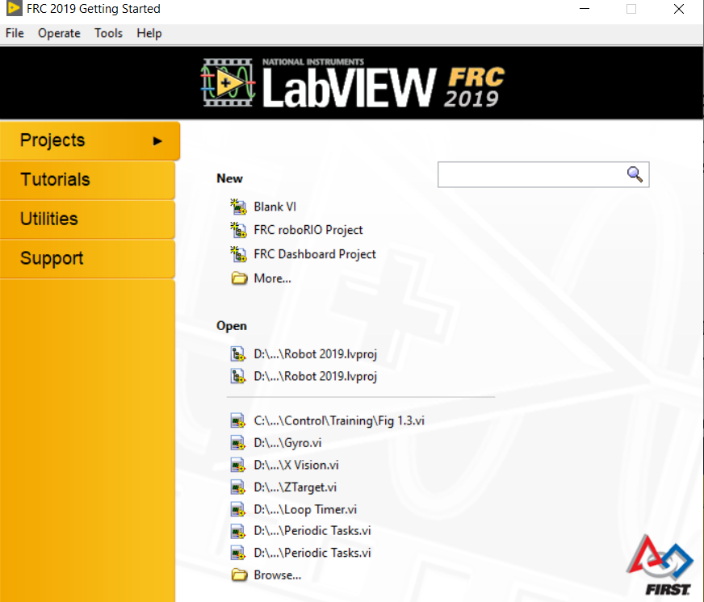
First Step - Complete before 1St Meeting: Download and Install Labview for 2019
Go to: https://wpilib.screenstepslive.com/s/currentCS/m/labview
(recently Screensteps is being replaced by FRCdocs)
Follow directions for “Installing Labview for 2019”
This will take a while each to download and install
When prompted the Activation code / Serial Number is: B04P63481
Once complete - follow directions on same page for “Installing the FRC Update”
This is much quicker
If all completed correctly when you open Labview it should come up with this: “Getting Started Window”
If a greyish window comes up you may not have
installed the update

Slide 3
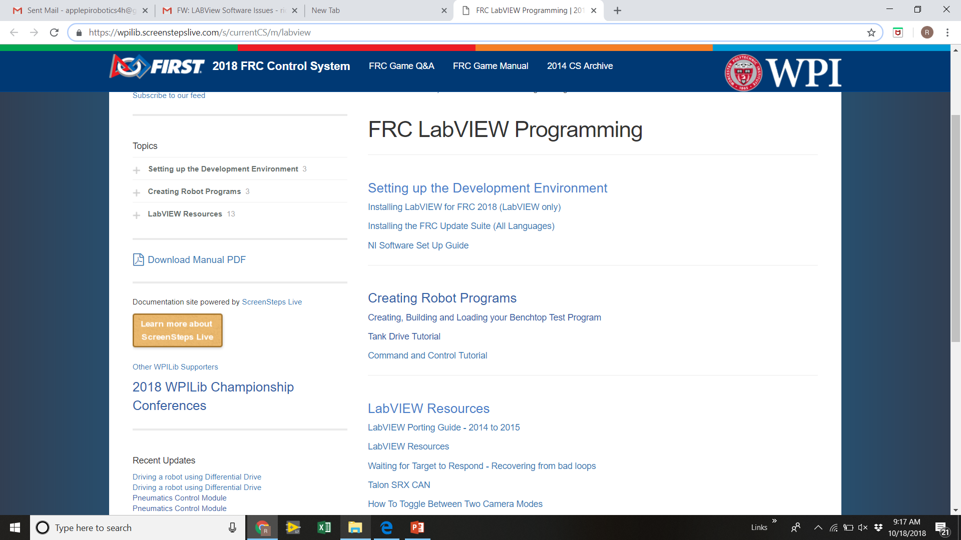
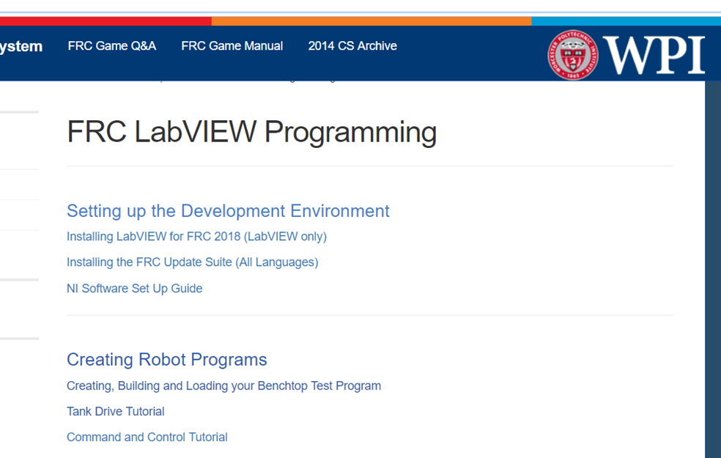
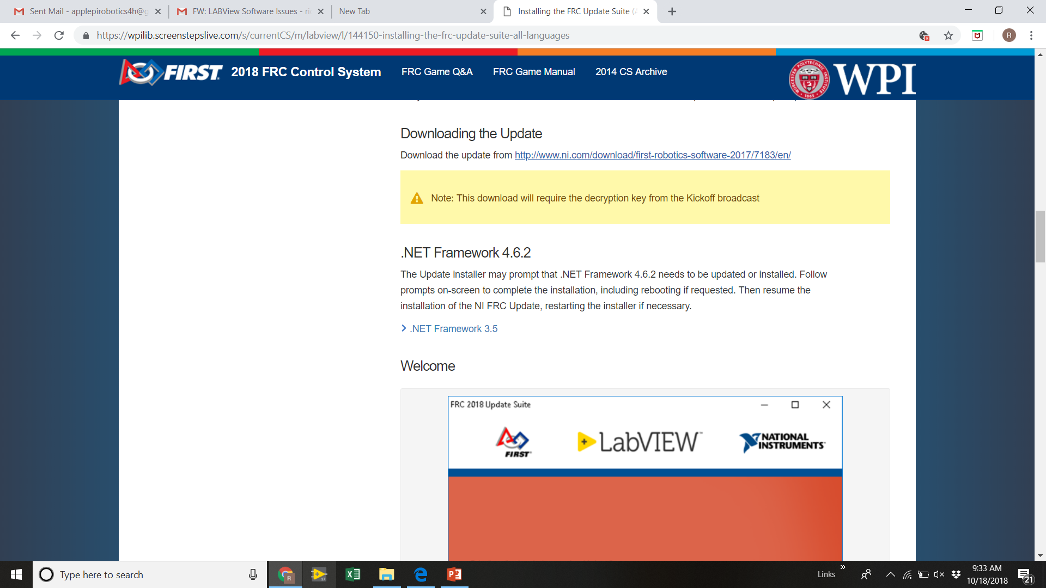
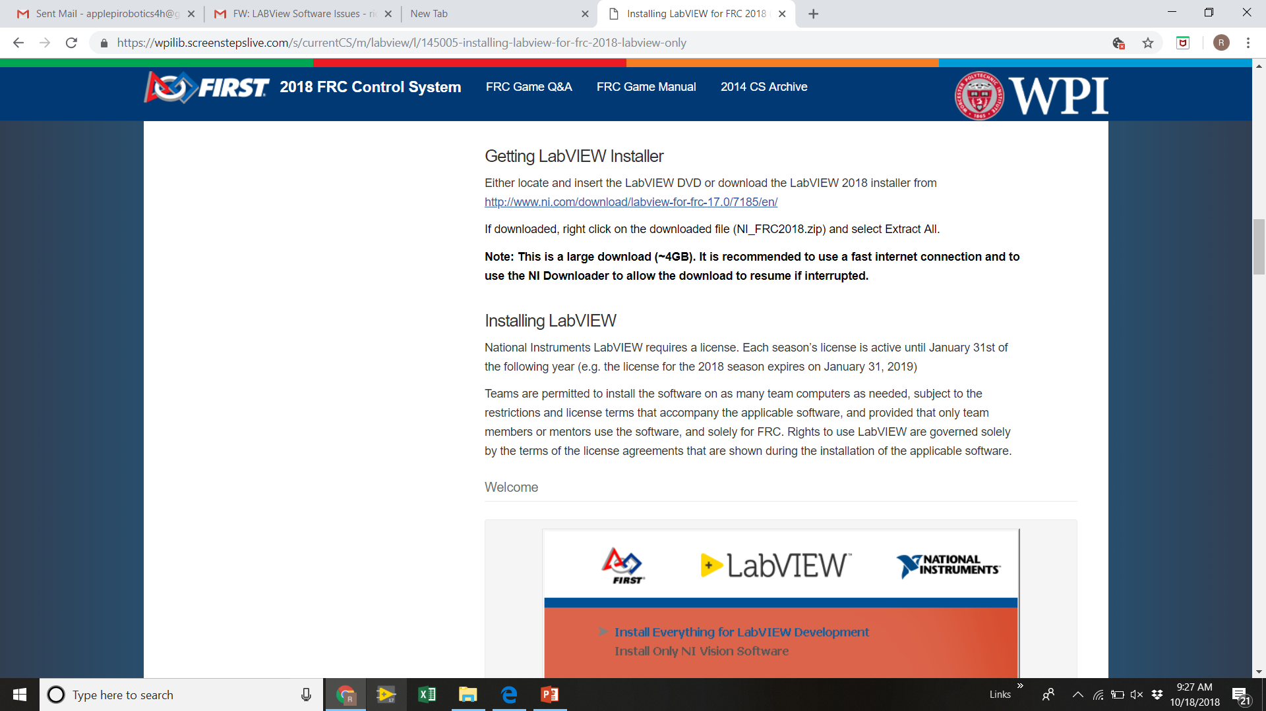
https://wpilib.screenstepslive.com/s/currentCS/m/labview
Click here
Next Click here
Brings you here, scroll down to
Brings you here, scroll down to
Download and follow instructions to install main Labview
Download and install can each take up to an hour!
Download and install Update Suite
Download and install each should be <15 mins

Slide 4
Second Step: Download “Secret Book Of Labview”
We will use the “Secret Book of Labview” for the introductory part of Labview familiarization’
Download (free) from Post # 21 on this thread:
https://www.chiefdelphi.com/forums/showthread.php?t=120756&page=2
Before proceeding with further slides here - which involve use of a robot
Work through the secret Labview book , follow its exercises - this is critical to have a solid foundation to proceed before getting on with robot specific code
In particular get through the Rocket launch example and the Vending machine example.
Once you demonstrate this we can move on to Robots!

Slide 5
Preliminary Curriculum
Secret Book of Labview
Through Rocket launch and Vending Machine
The RoboRio on board computer and wiring of control System
Tank Drive program - Basic robot project
Review Main, Begin and Tele-op VI’s
Add case structure in Tele-Op to switch between Arcade Steering and Tank Steering, use Logitech controller
Talon SRX - Download CTRE libraries
http://www.ctr-electronics.com/hro.html#product_tabs_technical_resources
CTRE Phoenix Framework Installer and install Phoenix Framework
Also download SRX Software Reference Manual & User Manual
Open / Run LV example, under CAN, 6 motor drive
Review updated Begin and Tele SRX drive blocks
Add and Read 2 drive Quadrature encoders
Add current limiting, (explore CTRE library a bit)
Move from Tele-Op to Periodic
Break into parallel loops:
Joysticks, Drive, & Mechanisms, as example.
Add global variables, e.g. to drive
Loop Timing
Mechanism Control
Absolute encoder seeding to quadrature
Arm - PID
Arm - Motion Magic include a form of gain scheduling
Shooter wheel - Velocity PID
Sequence – State Machine
Feedback control
PID control using Encoder reads
Drive forward and stop,
Bang- Bang, with coast vs brake modes, vs PID
Add and read Pigeon Gyro
Autonomous - State Machine set up
PID control in a square
Motion Magic instead of PID
Network Tables and Dashboard
Vision tracking
Sub Vi’s - making your own
Swerve Drive
Autonomous Fusion
Drive including motion profiling (or similar)
Mechanism coordination
Dashboard selection, Field API detection
Vision integration

Slide 6
What does programming the Robot DO?
Tele-Operated Mode - Joystick control
Program how motors and Pneumatics act to Drive Team Joystick Commands
Autonomous Mode - No drive team commands
Prescripted routine(s) that operate robot through a sequence of commands to execute game play for the first 15 seconds of match
Typically highly important to how the robot/Team will compete

Slide 7
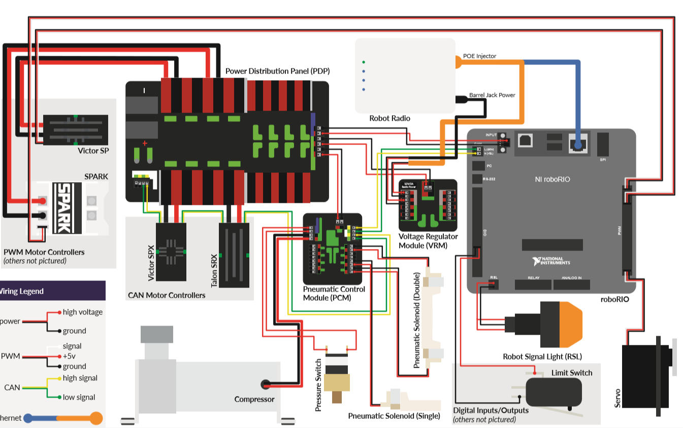
The Electrical Control System Programmers Need to Understand the System!

Slide 8
Connecting to the Robot: The Driver Station and Dashboard IP Addresses
WPI Screensteps documentation is very clear- find it at: https://wpilib.screenstepslive.com/s/currentCS/m/getting_started/l/599677-frc-driver-station-powered-by-ni-labview
IP Addresses: Every node on a internet network as a unique “IP address”
We are on a private network when connected to robot (unlike when connected to internet)
We need to provide IP addresses in 5 places to establish connectivity and run programs on robot
Continue on next slide

Slide 9
IP Addresses and connecting to robot, continued:
IP addresses for different Components:
RoboRio: 10.XX.XX.2
Radio (modem): 10.XX.XX.1
Laptop(Driver Station): 10.XX.XX.5 or 9 (5 if connecting Wirelessly, 9 if by Radio)
Camera or other accessory (Advanced Topic): 10.XX.XX.11 to 20 (unique # between 11 & 20)
Where XX.XX is team number so for us 20.67
5 Places needed to identify IP Address:
“Imaging” the RoboRio (will talk to that later, Our RoboRios are already imaged at this point)
Configuring the Radio, there is a utility that does this that is on your laptop with the download of the Update Suite. If connecting by Ethernet cord this is not applicable - Our radios are set for now
Configuring the Laptop WIFI or Ethernet IP address
In the Driver Station Set up - just give Team number and it takes care of it.
In the Labview Program Project File - We recommend using the “Static” IP address rather than the default auto variant
A 6th place may be if you have a camera or other accessory (e.g. a co-processor)

Slide 10
IP Addresses and connecting to robot, continued:
#1: The RoboRio IP address is set as part of the RoboRio Imaging process, which sets IP address and sets up the RoboRio for the programming language that is being used (Labview, Java, C++)
WPI Screensteps shows the procedure - we will skip that for now - as our RoboRio’s are already imaged - They will need to be re-imaged for next year.
but you will need to know the Team Number used on the RoboRio that you are working with.
RoboRio Web Portal to set Static IP???
#2: The radio IP address (if using Ethernet wire this is not required.
This is performed using the Radio Configuration Utility that is on your laptop as part of the download and install of the Update Suite.
This needs to be redone at competitions to connect with the Field management systems, and then reset after competitions to use for practice at home.
We will also skip this step for now as our radios should be set.

Slide 11
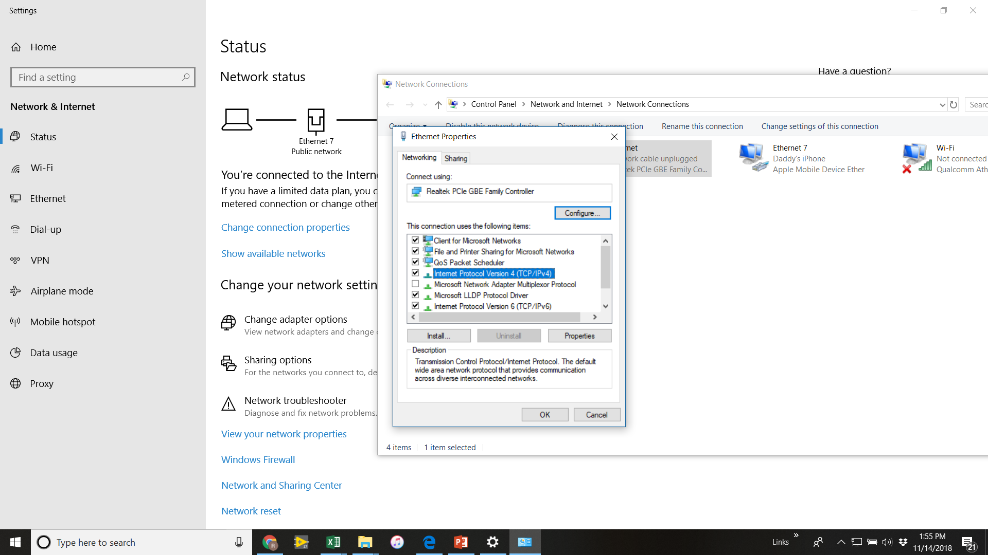
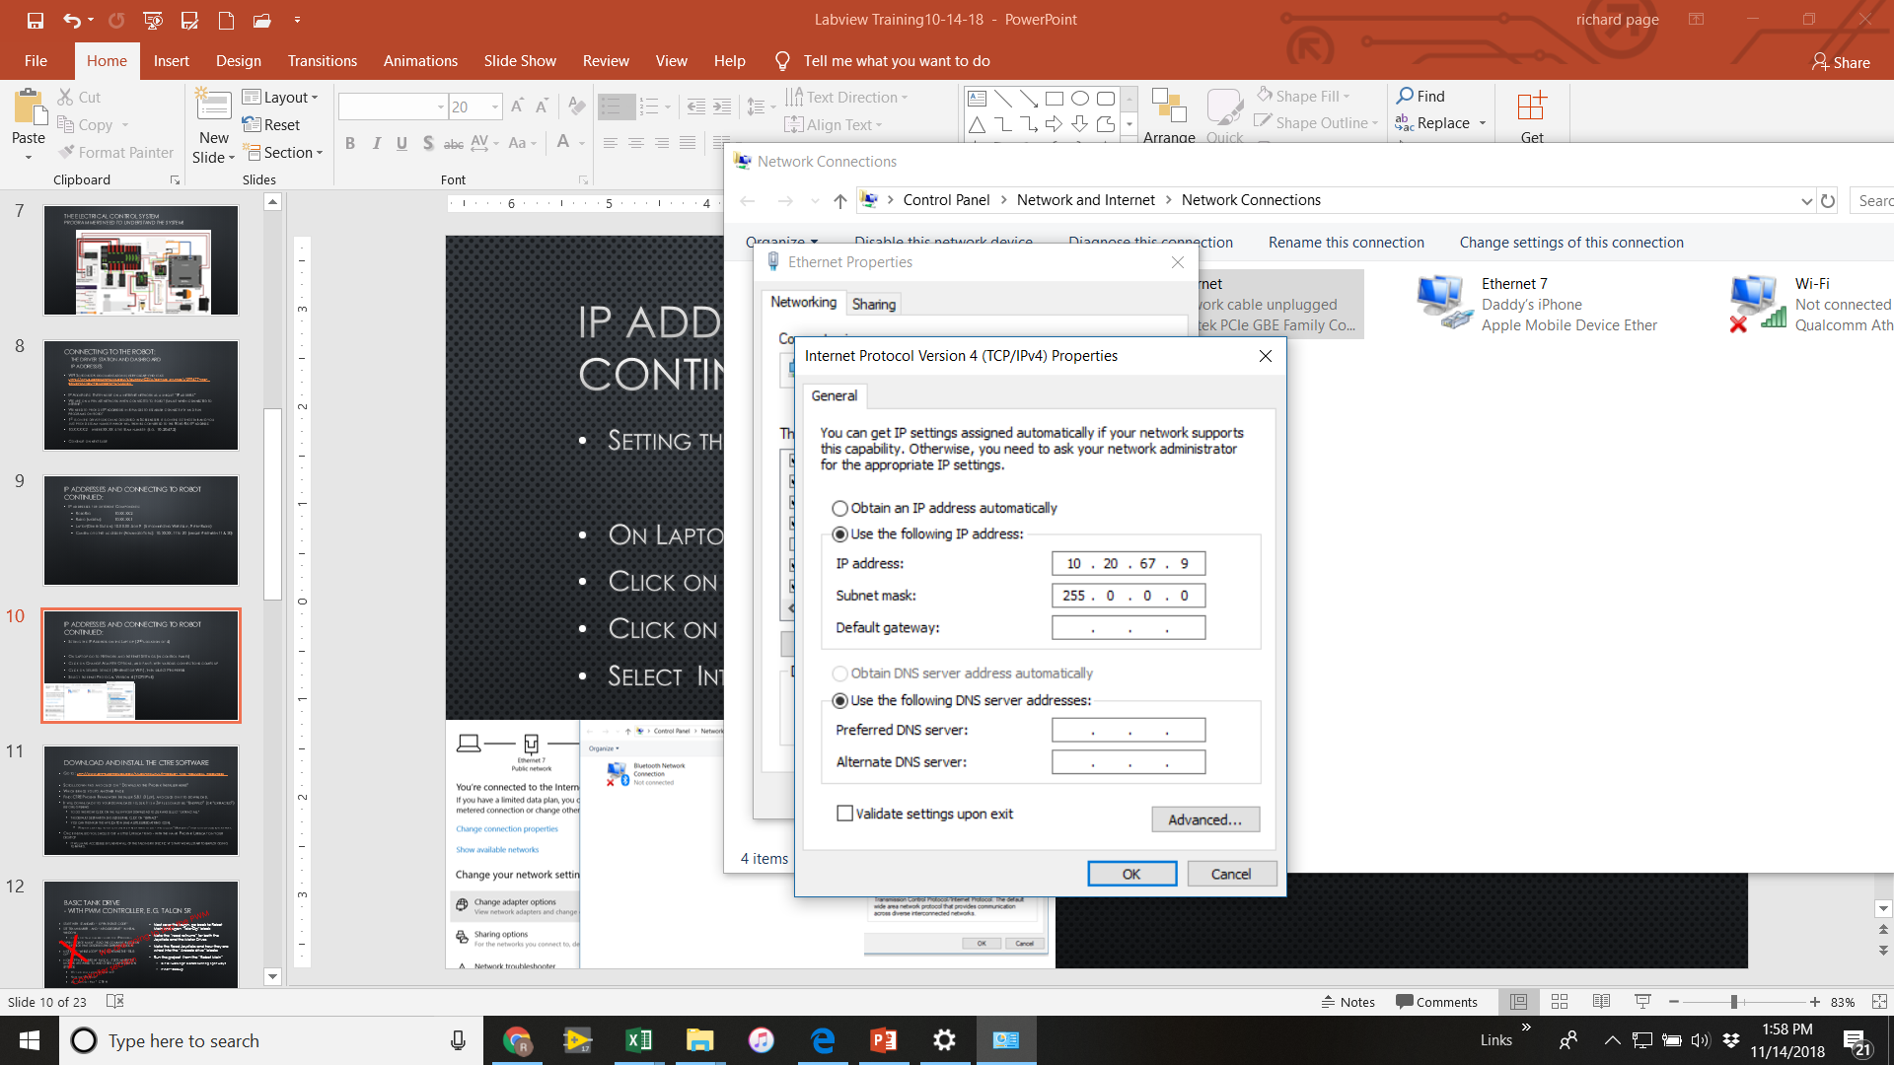
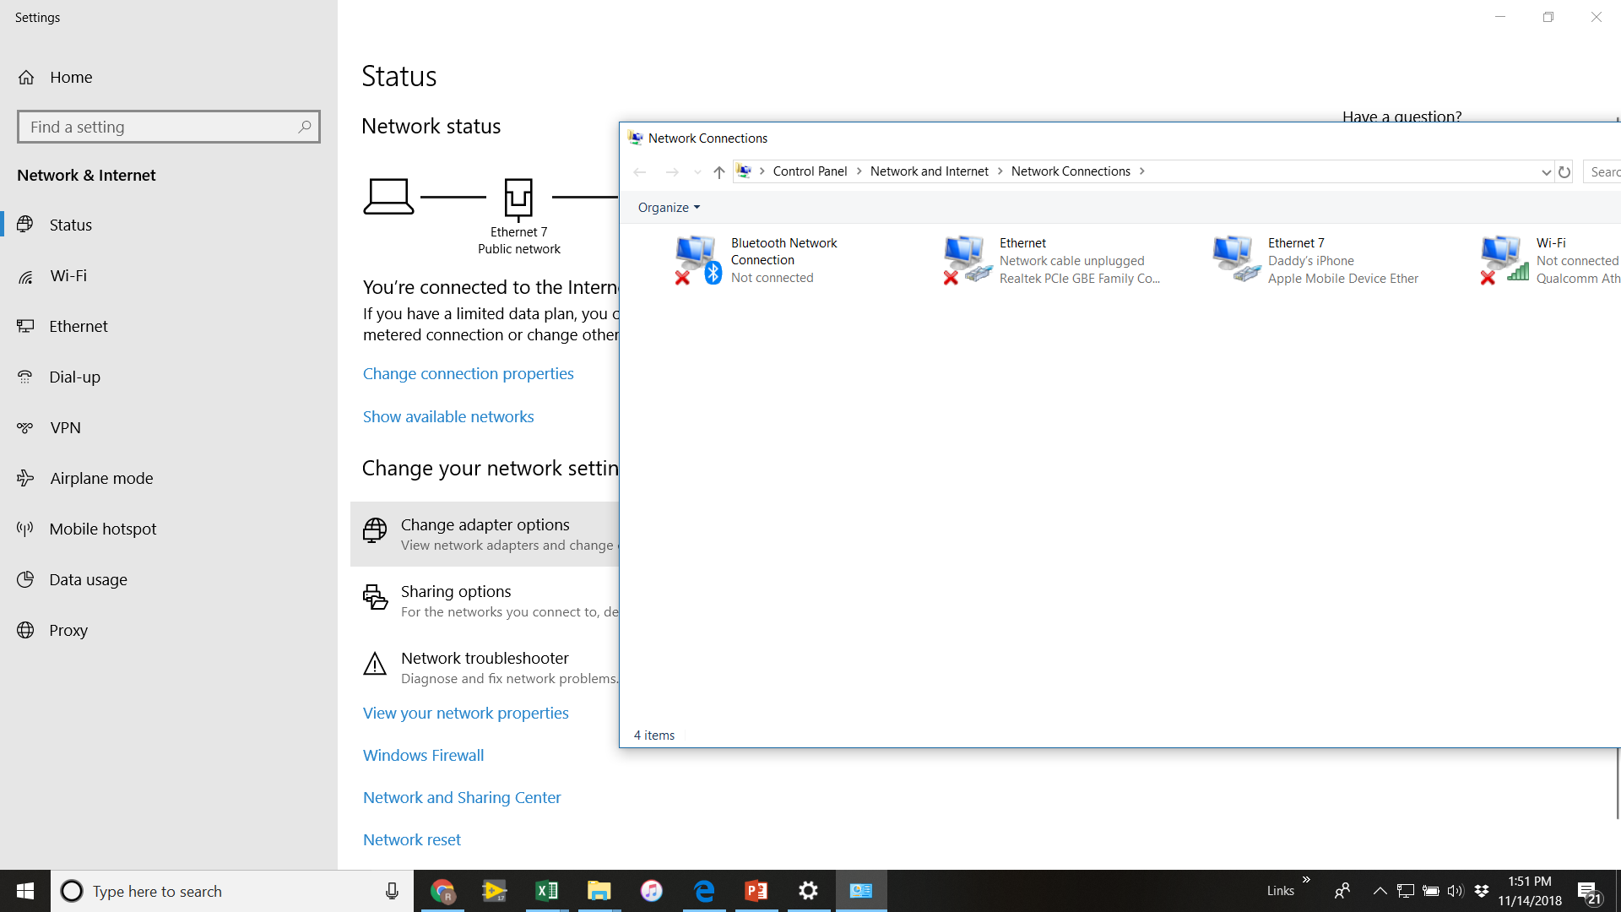
IP Addresses and connecting to robot continued:
#3: Setting the IP Address on the Laptop
On Laptop go to Network and Internet Settings (in control panel)
Click on Change Adapter Options, and panel with various connections comes up
Click on desired device (Ethernet or WiFi), then select Properties
Select Internet Protocol Version 4 (TCP/IPv4)
Click on the “Use the following IP Address” button and fill in the fields as shown (if team number is not 2067 then use appropriate)
Note you will need to go in and bring it back to “Obtain an IP Address Automatically” to get on internet! (for WiFi)

Slide 12
IP Addresses number 4 & 5
#4: The driver station, go to the Setup tab and enter the team number associated with the robot you are connecting, e.g. 2067.
#5: When you open a robot project it will ask for a team number it will then assign the ip address in the Labview Project Explorer
We highly recommend changing that by clicking on it, selecting properties and changing it to: 10.XX.XX.2 (The RoboRio address)
This is referred to as setting it as a “static” IP address

Slide 13
Download and Install the CTRE Software
Go to: http://www.ctr-electronics.com/talon-srx.html#product_tabs_technical_resources
Scroll down find and click on “ Download the Phoenix Installer here!”
Which brings you to another page
Find: CTRE Phoenix Framework Installer 5.15.1.0 (.zip) (or latest), and click on it to download.
It will download it to your downloads folder, It is a Zip file so must be “Unzipped” (or “extracted”) before opening
To do this right click on the file in your download folder and select “Extract All”
The default destination should be fine, click on “extract”
You can then run the application (has a little lifeboat ring Icon).
Windows may tell you it is an unsafe type of thing to do - if you click “More info” then can choose run anyway.
Once installed you should get a little Lifeboat ring - with the name Phoenix Tuner on your desktop
It will make accessible by Labview all of the Talon SRX specific VI’s that we will start to employ going forward.

Slide 14
The Phoenix Documentation and Tuner
https://phoenix-documentation.readthedocs.io/en/latest/index.html
Web Based tool to configure the CAN connected, CTRE components
The Talon SRX, Talon SPX, Pigeon IMU, Falcon Talon SX
Sets the Id’s of each component, Tests them and configures them.
The CTRE Documentation is extensive, It is important if not Imperative – to read through it and follow its recommended steps for commissioning a new control system – New means new to you! Make no assumptions that it is correct!
This can be tedious, but in the end you will find it saves time.

Slide 15
Basic Tank Drive - with CAN controller, e.g. Talon SRX The Phoenix Lifeboat software must be installed prior to this!
From Getting Started Window:
Got to “Support “ Tab
Then “Find FRC Examples”
Then “CAN”
Then “Arcade Drive”
Open project
Look at at Begin - note how they integrate CTRE Blocks for Talon SRX CAN drive, and also the follower mode with “Open 2Motor” Block
Copy these blocks into a new robot project Begin .vi
Replace the “Victor S” block with the “Talon SRX” blocks
Next review the “Tele-OP block”
Copy the robot drive blocks into your own new robot project TeleOp.vi
Please don’t modify the example itself - it loses the example for others and is prone to corruption
Now run your Robot Project- is everything good? If not try to debug - for instance maybe wheels are going backwards?

Slide 16
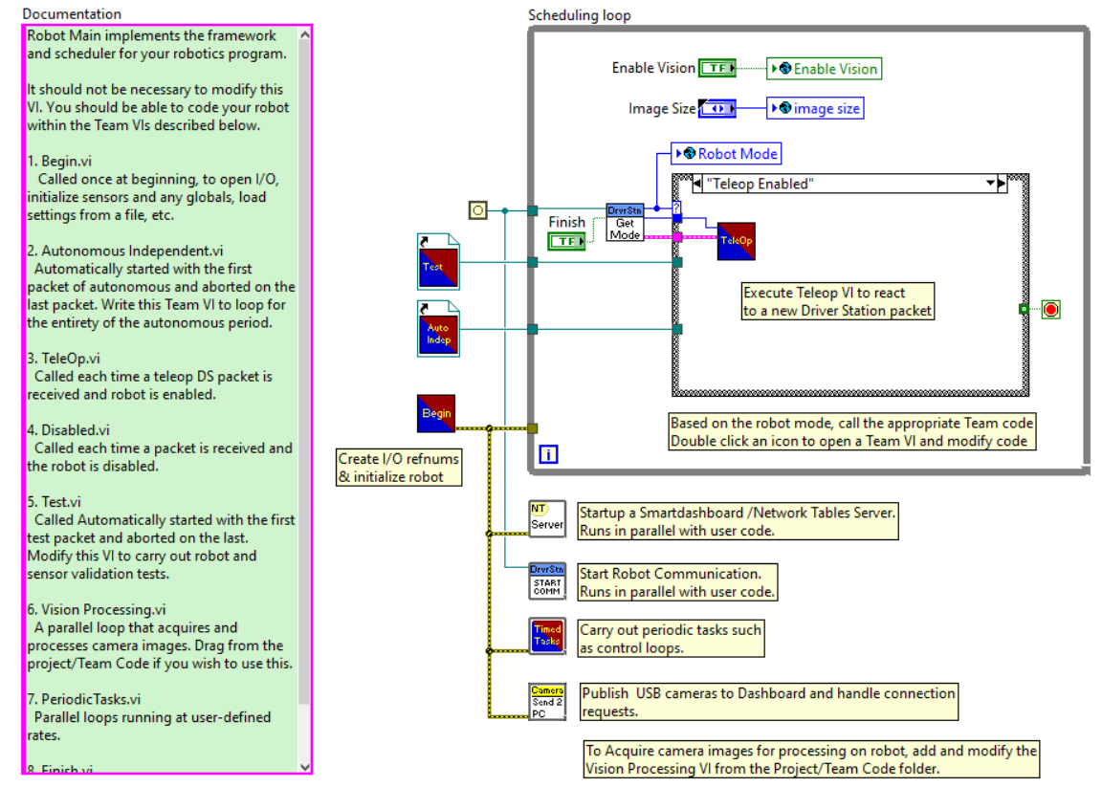
Robot Main
Robot Main calls all the other vi’s
Generally is not modified

Slide 17
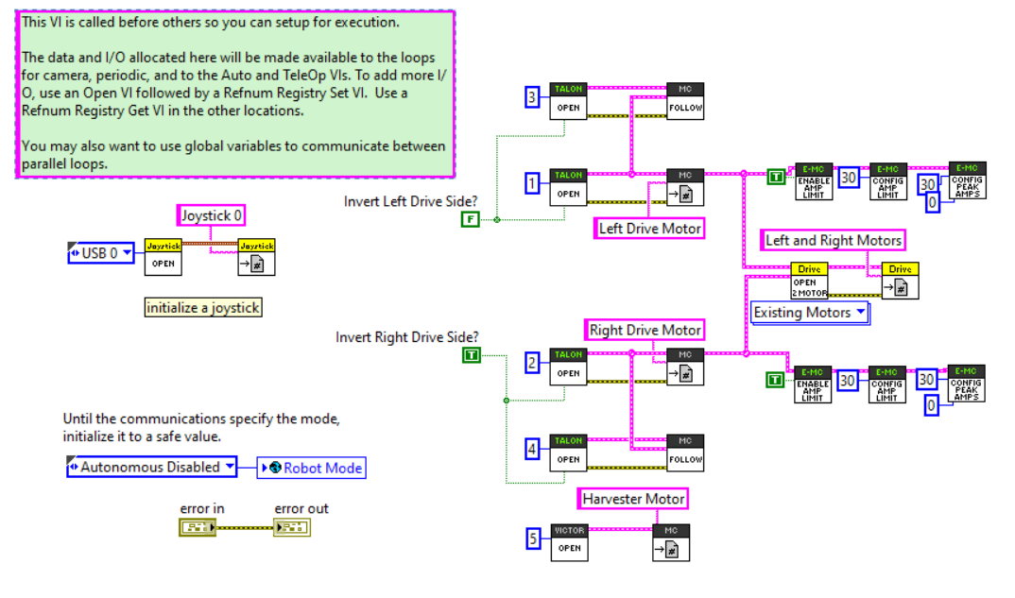
Begin.vi
Runs once only – no loop
Tells program where joysticks, and actuators are
Here: Drive motors are set up for CAN, Talon SRXs
Plus an additional Talon SRX Motor configured
Leave these things alone!

Slide 18
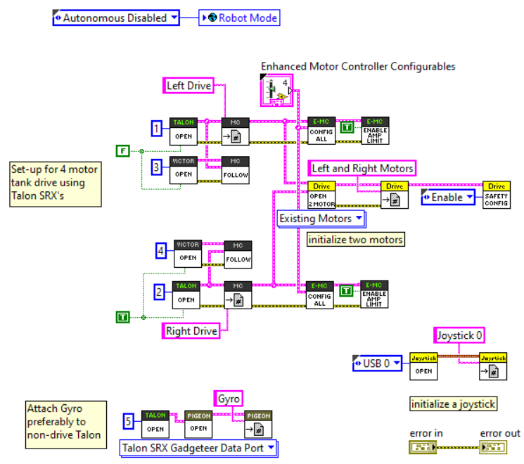
Begin – Using ConfigAll.vi
Config all
Sets all the Parameters in one place
Also by going through the list have clearer understanding of all the capabilities.
Double click to open the “Enhanced Motor Controller Configurables” block and find form for variables.
Find where you set the current limits and set.
Later other parameters will be used.
Also included: Pigeon Gyro configuration set up

Slide 19
Tele-OP
Tele-Op initially set up to run base read joystick and Drive operations.
Timed Loop (commonly referred to as Periodic Block) then would have accessory loops for solenoids or other features
However we have found (along with most other mature Labview teams) that it is better to put all into Periodic Loop
More flexible, better control of loops
Minimal calls are left in Tele-Op to keep drive station happy.
Next few slides will walk through first use of baseline Tele-Op and then moving all to Periodic.

Slide 20
Basic Tank Drive - Simple Modification of the drive Type
OK basic Arcade drive is working!
Now go to Tele-Op
Put a Case Structure Around the Arcade Block, make this the “True” case
In the “False” case put a “Tank Drive” block
Rewire Joystick axes appropriately for the Tank case – Using a Logitech controller
The “Index Array” right of the read joystick block identifies the individual axes
Which axes do you want wired for the “Tank Drive?”
Right Y axis and left Y axis – how to determine the numbering of the axes?
Add a True/False control on the front panel and wire to the case selector
Once you think it is set - run it from Robot Main
Debug if not behaving as you want it to
How would you make alternate Joystick (e.g. 2 separate sticks) as an option?

Slide 21
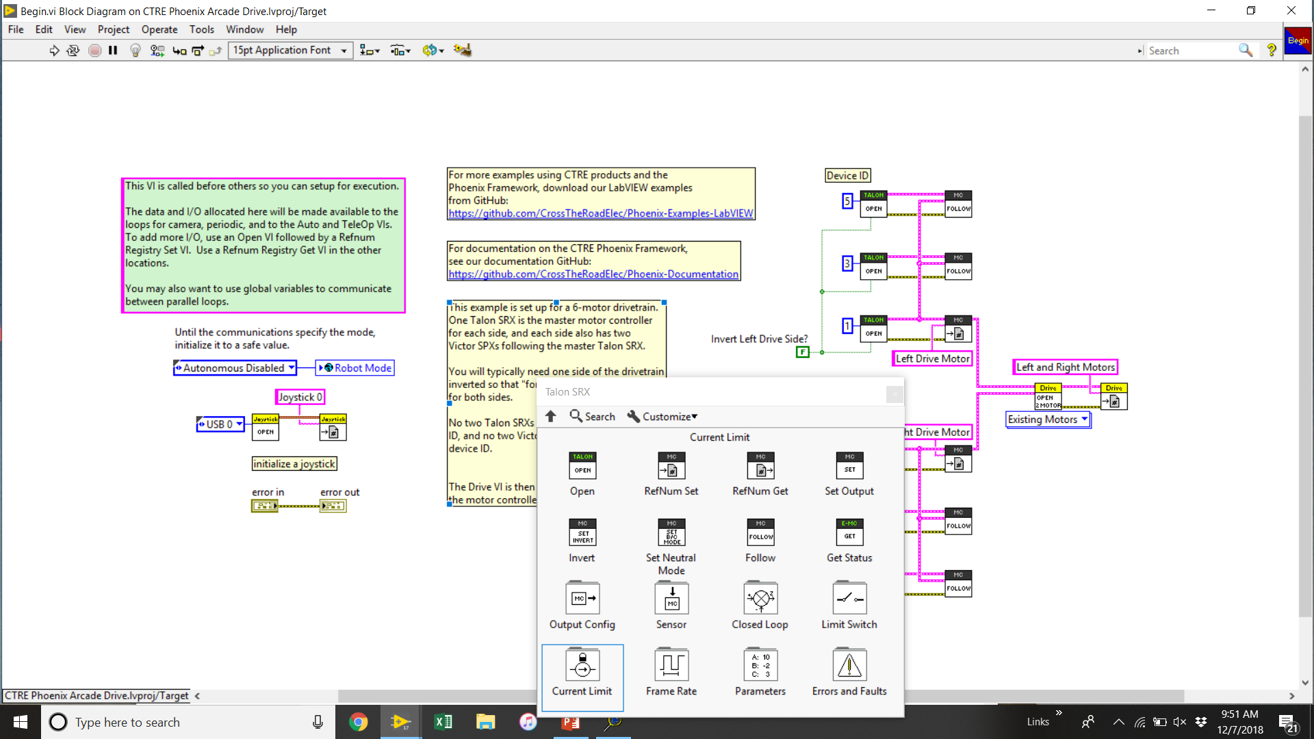
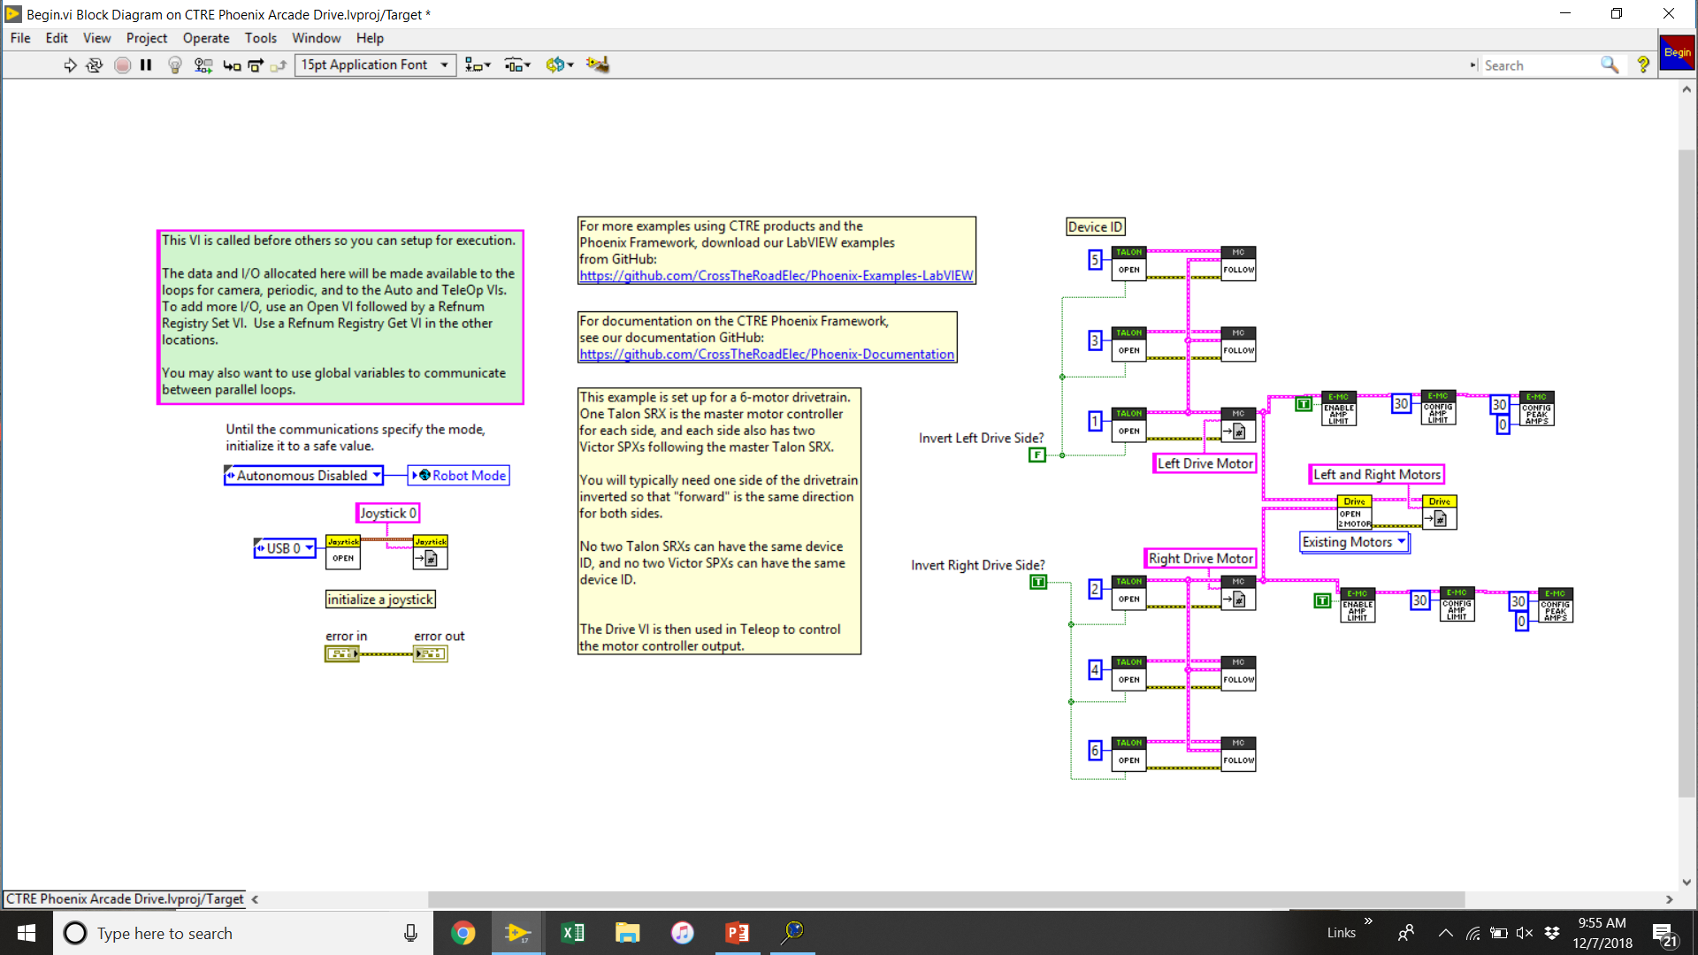
Let’s Now add Current Limiting Current Limiting is done to: (Discussion needed) 1) Protect from Brownout - if robot voltage dips below 6.75 volts, the RoboRio cuts power to motors 2) Protect from overheating Motors
Go to your Begin.vi
Open up function pallet - WPI Library, 3rd Party, CTRE, Talon SRX library and pin it
Open the “Current Limit” pallet
Bring all 3 vis out- Enable Current limiting, Config Amp limit and Config Peak Amps and add to the Left Drive and the Right Drive strings as shown
You do not need to add them to the “Follow” blocks
Add the constants as shown
You can change the values - the Config Amp limit gives the steady state limit
The Peak amps will allow you to set a higher level for a specified time (in milliseconds)
Even if you do not want a different peak level you need to have the peak level block, just set it to same value with 0 milliseconds - as shown
Can do within the Config All block instead of using the individual config blocks

Slide 22
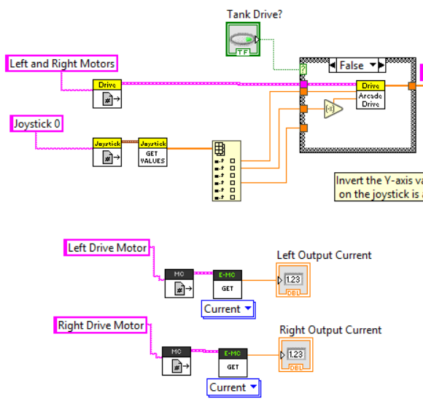
Current Limiting - Continued
Go to your Tele-Op.vi
Open up function pallet - WPI Library, 3rd Party, CTRE, Talon SRX library and pin it
Add a get RefNum for each of Left Drive Motor and Right drive motor
Then add a Get Status and select “Current” and wire an indicator to each as shown:
Save and run from Main - you can see the indicator on the Teleop front panel
You can try changing the Config Amp value on the left much lower - say 5 amps, and see the difference in behavior and reading value vs. right at 30 amps
To see effect best, drive robot against a wall (stalling motors, but not for too long!)

Slide 23
Use of “Periodic” or “Timed Task” block instead of “Tele-OP”
“Tele-Op” is convenient for simple drive codes, but once it gets more complex it is useful to not use it and prefer to put everything into the “Periodic” task block
Allows much more control of loop timing, and enables use of Parallel loops
Cut all the stuff (except the 3 things on the left) in the Tele-op block and paste it into the 10 ms timed loop in the “Periodic” task block - you will need to first make the loop larger to fit it all in
Note from the Robot Man block that the Timed task or Periodic Task runs in parallel - but is not inside of a while loop - so you need a While loop around the stuff that you want to run or be monitored continuously
The “Read Refnums” only needs to be done once so can be to the left of the timed loop - let’s move it there now
Now try to run from Robot main - does it still work as before? Debug if required

Slide 24
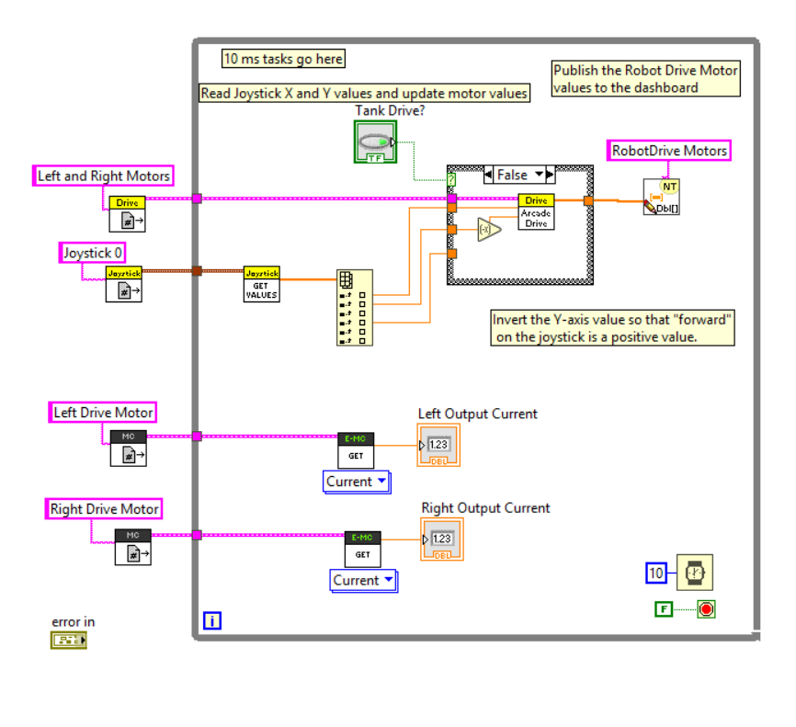
Use of “Periodic” or “Timed Task” block instead of “Tele-OP”
The result in the Periodic.vi should look like this:
Delete the stuff you copied out of Tele-Op - don’t want it duplicated
Run from Main - should behave same as before
If not - DeBug!

Slide 25
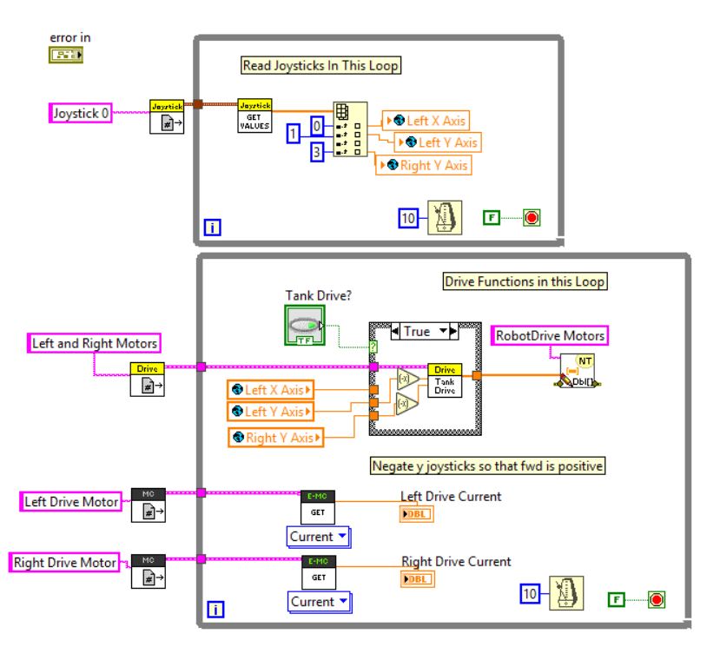
More Periodic Loop Development Parallel Loops
Next, lets create a second parallel while loop, also with a 10 ms timing
Put the Joystick read commands in one and the robot drive in the other - but do not try to “wire” the joysticks from one loop to the other
This would cause the two loops to be often waiting for one another to provide info.
Add “Global Variables” For the 3 Axes (recall how from Secret Book?! If not use the Labview Help - look for Global variables )
In the Joystick loop write the axes to global variables
In the drive loop change them to read, and wire to the appropriate drive blocks
Run this from Main - Should behave same as before

Slide 26
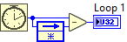
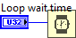


More Periodic Loop Development Loop Timing
Lets find out how fast the loop is actually running
Add in logic to read loop timing and display to Front panel
Use a Feedback node and tick counter as shown here to the right:
Drill down through periodic loop and open the “Swerve” Block code
Add into code - one in each loop - this is a good regular practice for while loops
Change loop time wait parameters to be controls also.
How fast are the loops actually running vs time requested ?-
Change loop time definition from to . Do you see a difference? Look them up with Ctr H.
As the code increases in complexity it is easy to get bad (long) loop speeds if not careful! (Asking to perform too many operations in too little time)

Slide 27
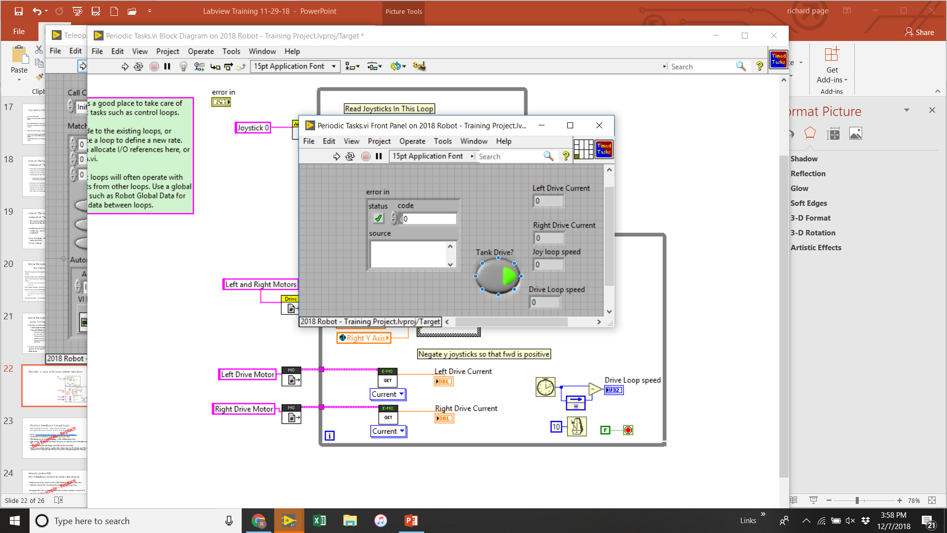
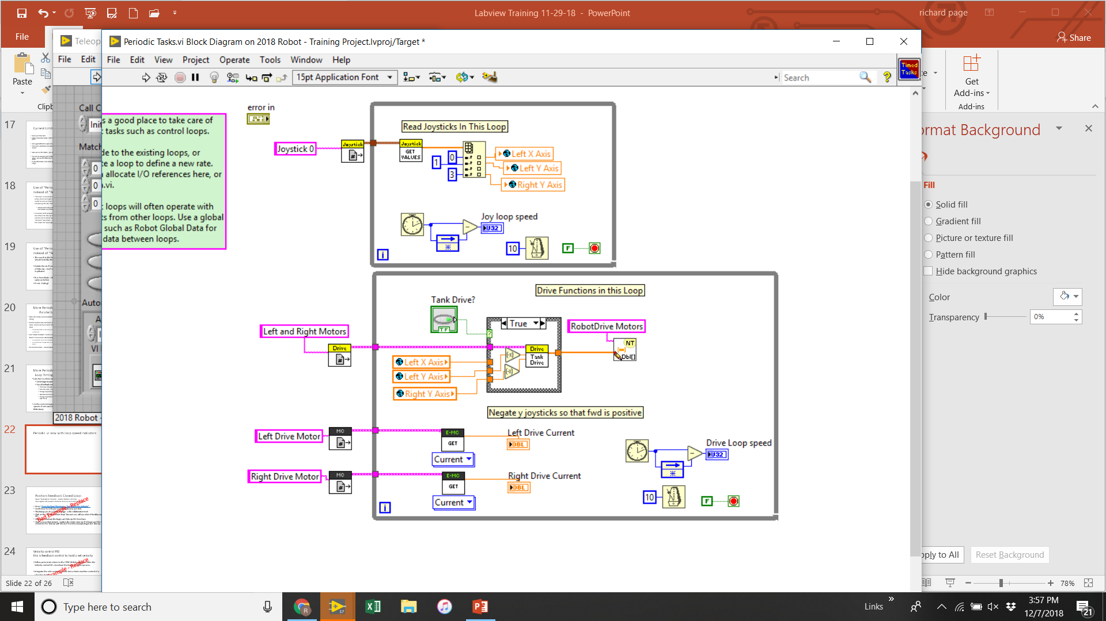
Periodic.vi Now with Loop Speed indicators
As code gets more complex you will likely find that the loop speed exceeds 10 ms.
It is best practice to have loops that depend on one another run at same loop speed
Some functions do not require high speed and shoot be set to slower loop speeds to reduce load on RoboRio

Slide 28
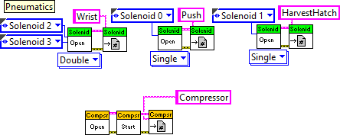
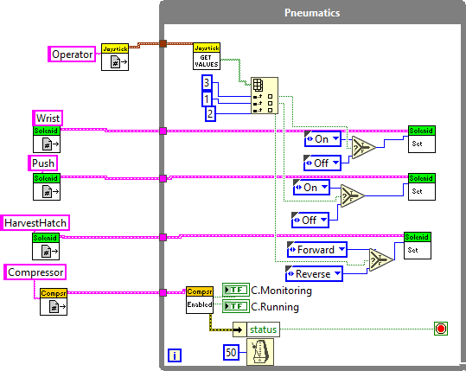
Pneumatics
In the Periodic.vi:
Form another loop, typically 50 ms or so
The compressor block – set up to automatically monitor the pressure switch and turn it on and off
Place cursor on the “Value” port on the solenoid set block, create a constant – you will see it creates an “Enum” with 4 possible values, On, Off, Forward and Reverse
For Single solenoids – On or Off
For Double: Fwd and Rev.
This code reads buttons,
If one is pressed,
actuates a different solenoid
In the Begin.vi:
Get the blocks from the WPI Library
Note “Double” vs. “Single” solenoids,
Does the solenoid have actuators on both sides or one?
Most times only need a single solenoid

Slide 29
Global Variables - How to From Secret Book of Labview P. 55
“If you need more global variables (and you will), simply drop whatever controls and indicators you need onto the front panel of Robot Global Data.vi. (This is already included in the basic Robot Project).
To add a global variable to a VI, right-click on the block diagram, choose Select a VI…, and then select Robot Global Data.vi. Once you have the variable dropped, click on it to choose the actual variable you want from the pop-up list.
As is the case with everything else, these globals need to be set for reading or writing, just like local variables. Once you have one global in the diagram, the easiest way to get more is by the control-drag method. “

Slide 30
Lets Make a Electric Catapult Program PID Position Control of a motor with an encoder
In Begin Open another motor (Talon SRX) and assign to a RefNum with name “Catapult”
Create a new loop in your Periodic Task
Read Refnum outside of and wire to a Talon SRX Set.vi inside loop, use control mode = Percent Output
Also use a Talon SRX Get block to read the Quadrature Encoder Position (1 revolution = 4096 units)
3 States: Ready, Shoot, Reset
In Ready state:
Motor output should be set to 0 (wire from inside case to Set.vi)
Monitor a Joystick button (use a global variable from the Joystick loop), when pressed true, go to Shoot state (use a selector)
In Shoot State:
Motor Output should be wired to a slider control - Slider range from 0 to 1
Monitor the quad encoder value and when it exceeds a control value for the stop position go to reset state - stopping the shot.
This is referred to as “Bang-Bang” control - on/off suddenly
In Reset State:
Motor output should be set to -0.2
Monitor quad encoder to a relatively small value (say 200) and then go to Ready state - arm should coast (and gravity) down to the zero position
Try running this - with just a motor without an arm on it until feel good about it
Make sure encoder reading make sense and are not reversed - Use the Phoenix Tuner, Selftest
Adjust control values to run how you want it to
This is a primitive form of Feedback control
So next we will add PID Feedback control to make smoother!

Slide 31
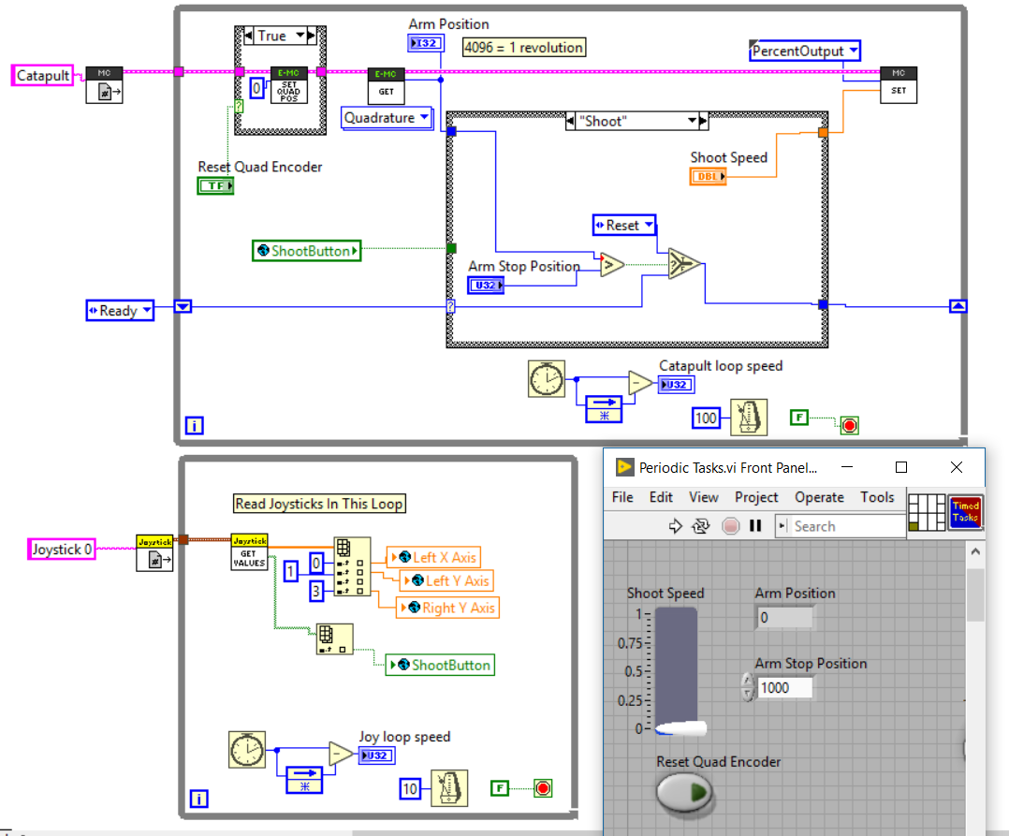
Electric Catapult - Bang-Bang Version
All in Periodic.vi loop
The state machine can run at a slower loop speed - use 100 ms
The feedback aspects are done inside the Talon SRX microprocessor running at a 1 ms loop speed
Begin.vi changes not shown but you can figure that out by now!
Also other cases(states) not shown but should be able to figure them out also

Slide 32
Position Feedback PID Control
Prior example was simple form of Feedback control - “Bang-Bang”
Like thermostat in your house - Sensor monitors a parameter once it hits a certain value it turns on or off suddenly - Bang-Bang
PID control smooths out the control of the “Error”
P= Proportional - it will close the Error proportional to the amount of the Error
I = Integral - It will observe over time the amount of error and work to close it - In practice sometimes the Error won’t fully close with just P and a little I term helps - but can be very sensitive
D= Derivative - It monitors the speed of error closure and can dampen the response
As a first cut you can just use P, then later play around with the I and D terms
Read up on the PID section in the Talon SRX Software Documentation
Link from the CTRE site - tech resources
https://phoenix-documentation.readthedocs.io/en/latest/index.html

Slide 33
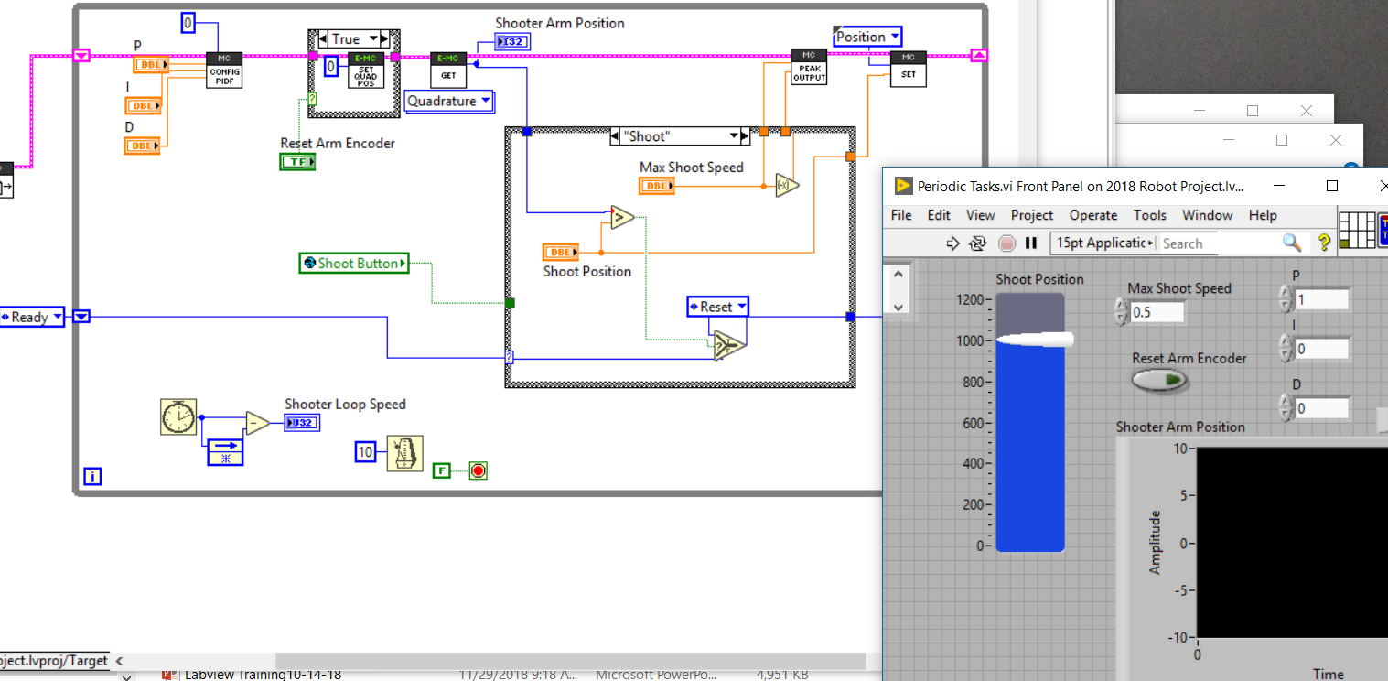
PID Control of Electric Catapult
Add a Config PIDF block and add P,I,D controls, and set “Slot” to 0 (use Control H)
Add Peak Output block, this will set the maximum speed the feedback control will give to close the error, Wire it to your shooter speed control - with a negate for reverse - as shown
On the “Set” block change control Mode to “Position”
Now instead of setting speed, you are providing position - in encoder units (4096 = 1 rev)
On Front Panel change the slider to Shoot Position (instead of speed) and change range to 0-1200
Also on front panel replace the Shooter Arm Position numerical indicator with a Waveform Chart
Now need to Tune the PID:
While tuning in the shoot block change the “enum” to shoot so that it stays in shoot mode
Set max speed to 0.9
Set shoot position to ~1000 (~1/4 rev)
Start with a P of 1
Run code, enable and press shoot button
If motor goes unstable (oscillating) reduce P
If motor responds sluggishly increase P
Well tuned if it slightly overshoots then settles
Use the waveform chart
Often you only need P but read reference manual and follow their direction for D and I tuning.
After tuned, change “enum” back, run and make sure it all is good!
Also put the config PID outside the loop (Or in Begin)

Slide 34
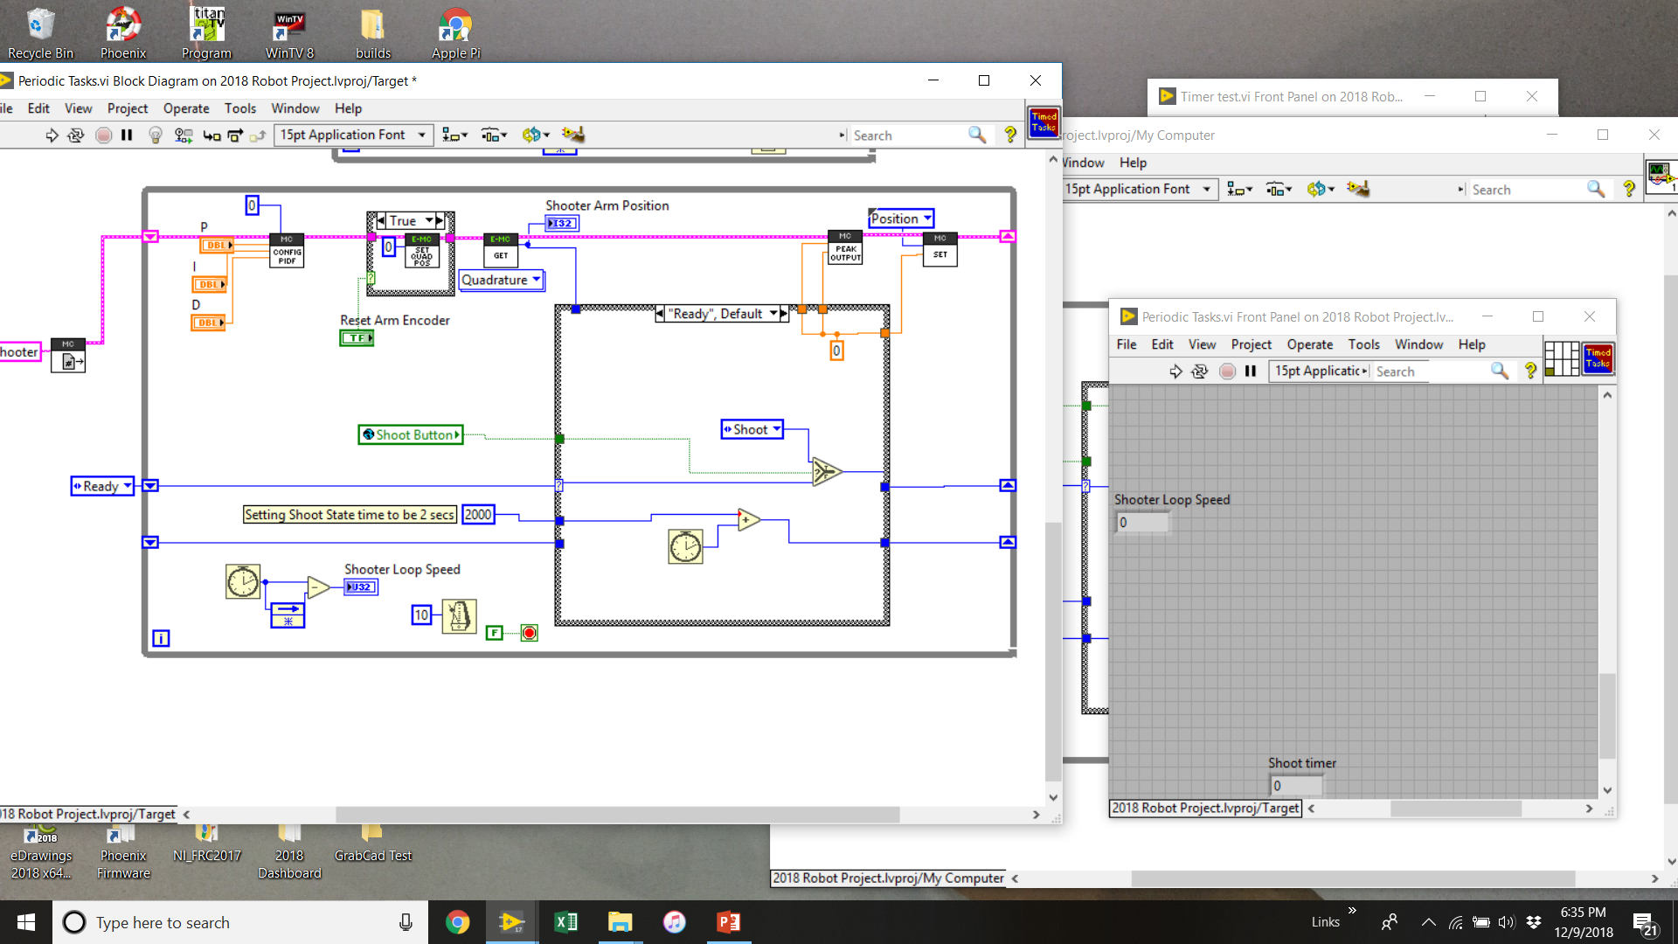
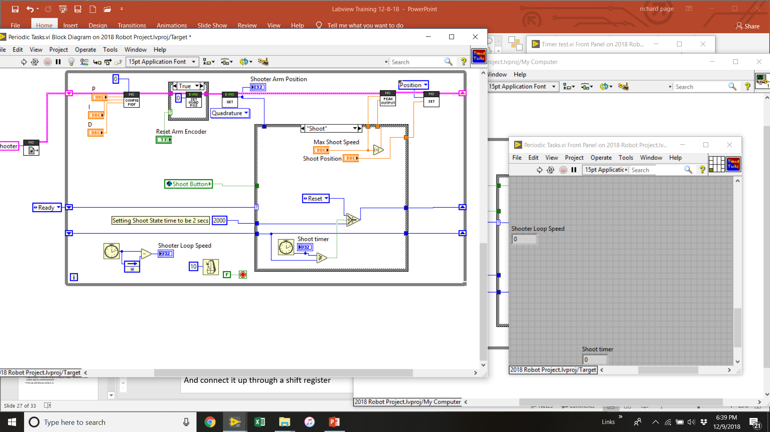
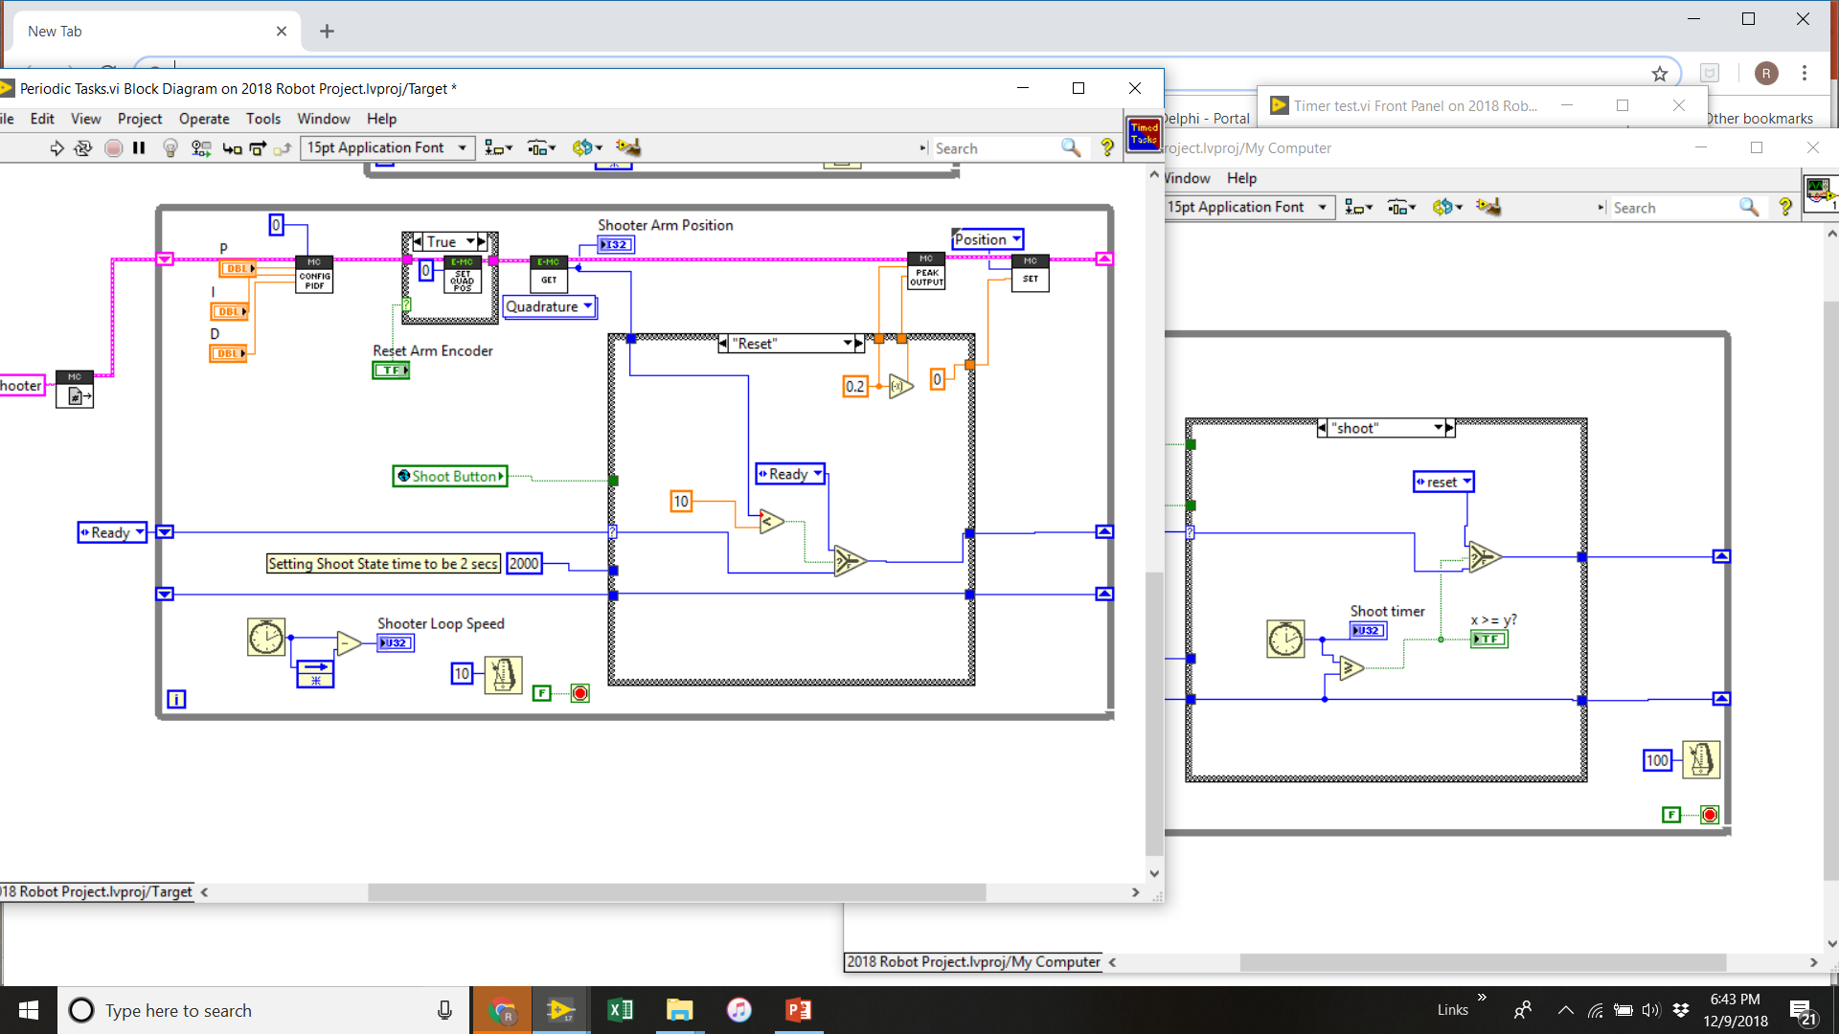
PID Control with a Timer added
In prior example the state changes from Shoot to Reset when the encoder reading hit the target value - Sometimes this will not be desirable as the response has not fully settled out - or other times the response may not get all the way there and you still want it to move on
So instead we can put in a timer element and set it to a value that you know is long enough to settle but short enough to complete other tasks and not get stuck
Here is an example of how to do this:
In Shoot case start another shoot timer,
compare it to the shift register value
Once it exceeds it will change the state
For the Reset case just pass the timer though keep the shift register good for next cycle
Add a tick counter in the Ready case add desired shoot case time t it
And connect it up through a shift register

Slide 35
Were you successful at PID tuning?
If so - congrats!
Give your self a pat on the back - it’s a big step toward knowing robot control!
Take a breath - now we will got to Motion Magic - which is an even cooler way to control position
First we will discuss what it is.

Slide 36
Motion Magic - Overview
In Position control we want to move something from A to B
From a motor viewpoint a certain amount of rotation(s)
Lets say we know the max speed and acceleration of the motor we want to control
This can be done by running it and reading a waveform graph, or approximating knowing the specs of the motor and gear ratio - we want to know these values at the point it is being measured by the encoder
We then also can define how fast we want the motor to run and accelerate to get to the desired position (close the error) - This can not be greater than the max speed and should be less to account for battery voltage drop - so say max of about 90% of max speed - sometimes you want it to be slower
Now if you know acceleration and velocity you can create a “Trapezoidal Profile”
Constant Accel for Time = Taccel until reach cruise velocity, T steady state until time to decel to 0
Motion Magic routine in Talon SRX library does this easy for you
But left at that there will be error since there will be friction effects and other causes to deviate some from the profile
So we add PID control on top of the trapezoidal profile to correct any deviation
Net effect is a tighter level of control and ability to control more difficult systems.
Read the Motion Magic Section in the Talon SRX Documantation
A
T_{accel}
T_{steady speed}
T_{decel}
B
Distance (A to B) =
½*accel*(T_{accel}²+T_{decel}²) + velocity*T_{ss}
= accel*T_{accel}² ₊ Velocity * T_{ss}

Slide 37
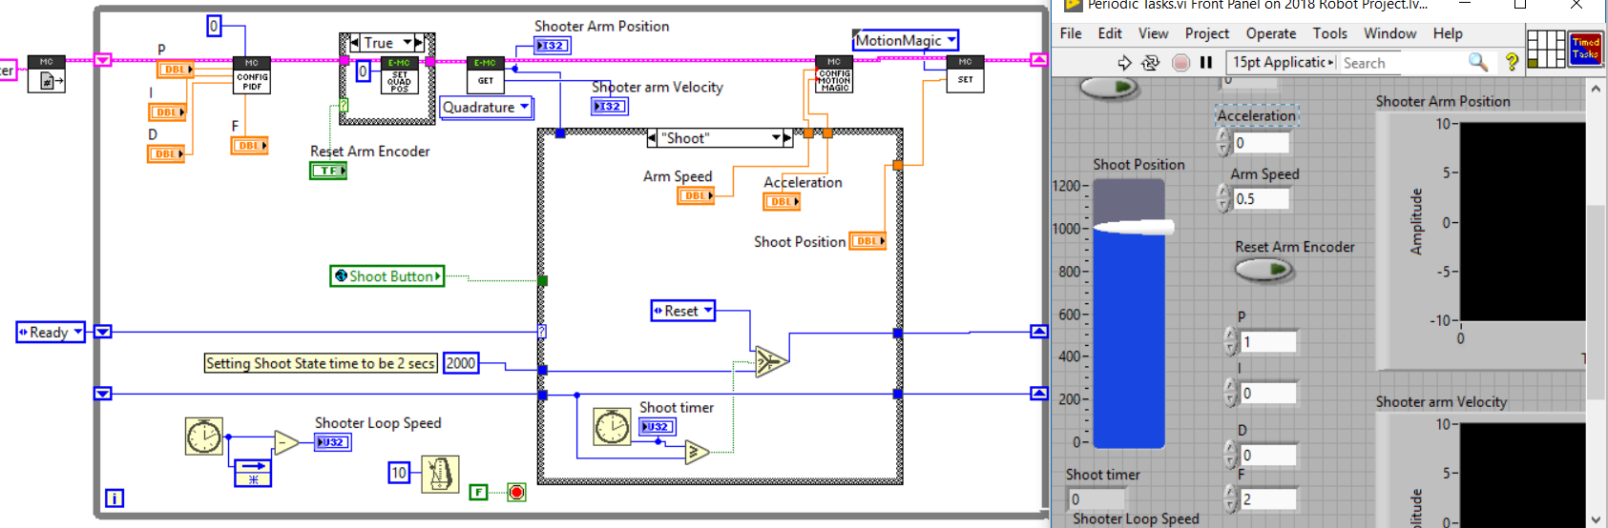
Motion Magic: Implementation
Changes from PID example:
In SET.vi change control mode to “Motion Magic”
In Config PIDF.vi add a control to the “F” terminal - this is a “Feed Forward” term
On the Get.vi for reading encoder - wire a indicator to the velocity output, on the front panel change this to a Waveform Chart
Add a Config Motion Magic.vi (from closed loop pallet)
For ready case wire these both to a constant=0
For shoot case wire each to a control - Arm Speed and Arm Acceleration
For Reset case wire Velocity to a constant value of ~50, and the Acceleration to ~ 400 (we may adjust these later
Tuning the parameters will be on next page

Slide 38
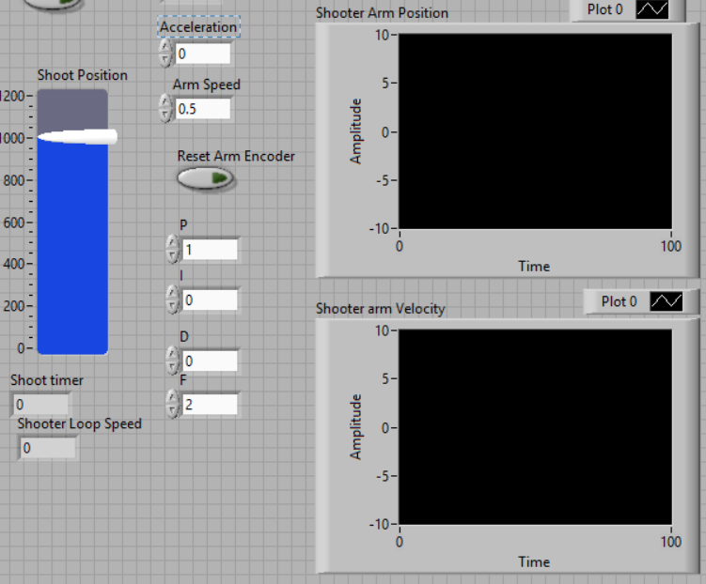
Motion Magic - Tuning
Read the Motion Magic section in the Talon SRX Software Reference Manual
Particularly Sections 10.7 and 12.6
From there we see that:
F= 1023/((Motor Max RPM /600)*4096)
We can test or approximate
Approximating - we know the 775pro free speed is 18730 RPM and it is in a 100:1 gearbox so encoder reading a 187 RPM free speed, laded down through gearbox should make it around 170 => F gain initial guess = .88
Now set P,I,D all to 0
Run program - adjust F until it runs about to right distance
Now can add P value to make it run tighter and not deviate - again increasing until unstable then backing off a bit.

Slide 39
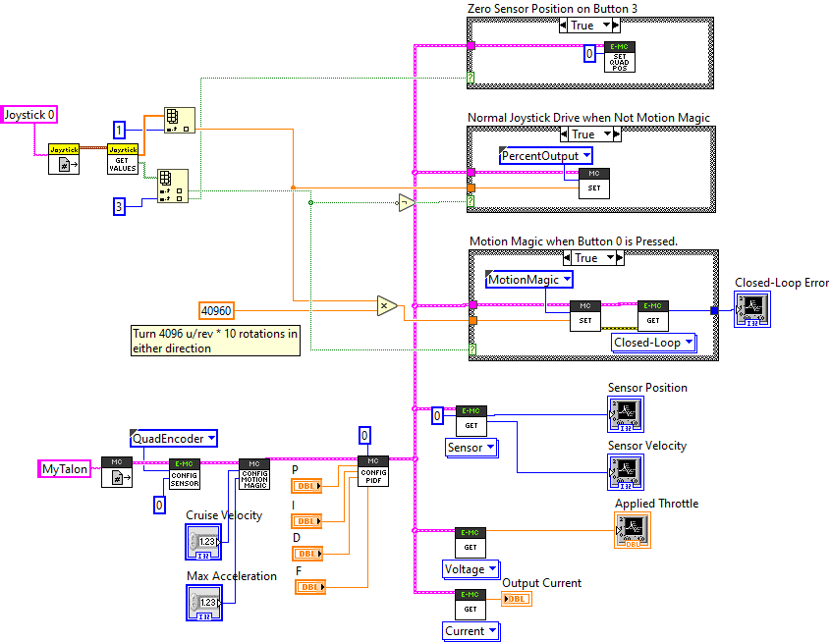
Motion Magic – CTRE Example
From the CTRE Labview examples here is the Teleop code
Should be equivalent to prior slides
Suggestion put Sensor config and PIDF stuff into Begin once they are tuned – this reduces load on the loops.
Also recommend having this in a loop in Periodic rather than Tele-op

Slide 40
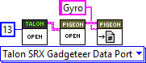
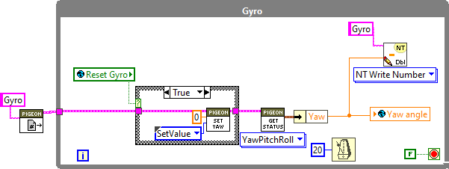
Read Gyro “Yaw” angle, also Reset Gyro angle
Gyro outputs Yaw, Pitch and Roll angles – typically interested in Yaw
In Begin:
We use a “Pigeon” gyro (there are several other types) offered by CTRE, and it pugs directly into a Talon SRX to get on the CAN network
The following is put in the Begin: to configure it:
In this case it is plugged into SRX with a CAN ID #13
In Periodic:
This loop will read the pigeon gyro and find the Yaw angle
And write it to a global variable for use elsewhere.
It also “Resets” the Gyro if the global variable
“Reset Gyro” is true (usually tied to a button).
Resetting gyro sets the 0 degree heading to how the robot is
oriented at the time the button is pressed.
Also it writes the value to a “Netwrk Table” which is a way to get data back to the laptop, Dashboard (later topic)

Slide 41
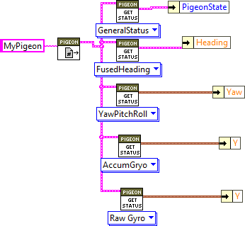
Gyro Continued
Lets explore the different types of output from the Pigeon
Put the Get status commands shown in a periodic loop
Look at the differences
Look in the Pigeon software documentation for a discussion of differences – in particular section 8 sources of error
http://www.ctr-electronics.com/downloads/pdf/Pigeon%20IMU%20User's%20Guide.pdf

Slide 42
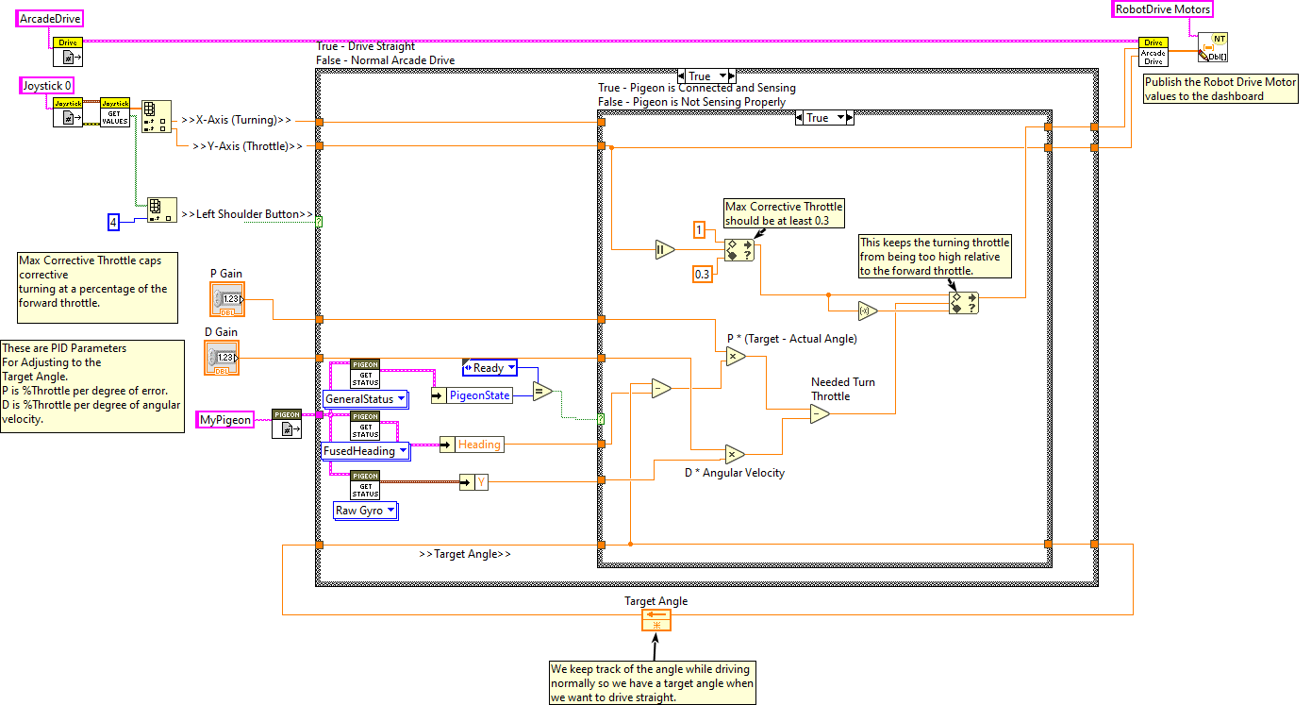
Drive to an Angle with a Gyro
This is a example from the CTRE documentation
Down load the Teleop.vi to get what is shown here
https://github.com/CrossTheRoadElec/Phoenix-Examples-LabVIEW
This is also a clear example of PD loop control
without using a PID block
The P (proportional) term scales the motor output to the degree of error in heading
The D (derivative) term scales with the rate of change of the gyro heading

Slide 43
Autonomous Drive Challenge
Set up a Motion Magic control of the drive wheels
Have robot drive fwd. 6 ft, then turn 90 degrees, then drive 4 ft and stop.

Slide 44
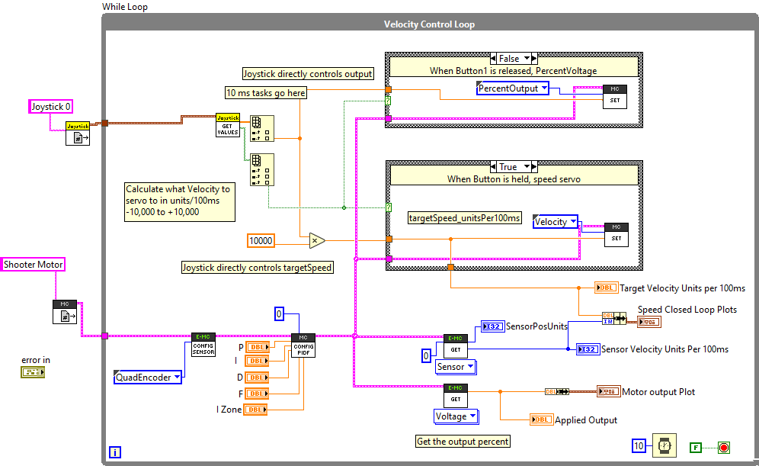
Velocity PID Control
Get the Tele-op.vi from the CTRE velocity control example
https://github.com/CrossTheRoadElec/Phoenix-Examples-LabVIEW
Put it in a while loop in a new project Periodic loop – should look like this ➔
In the Begin open up the corresponding Joystick and Talon SRX devices, refnums
Hardware – have a Motor on a Versa-planetary, with a VP encoder plugged into a Talon SRX
Set the CAN Id with the Phoenix Tuner and also conduct the self-test to ensure encoder phase is correct.
Read the SRX documentation on how to set the PIDF values
Run, look at charts
Change the velocity control to a slider – instead of joystick
Try using with a ball shooter
And optimize speed recovery after each shot.

Slide 45
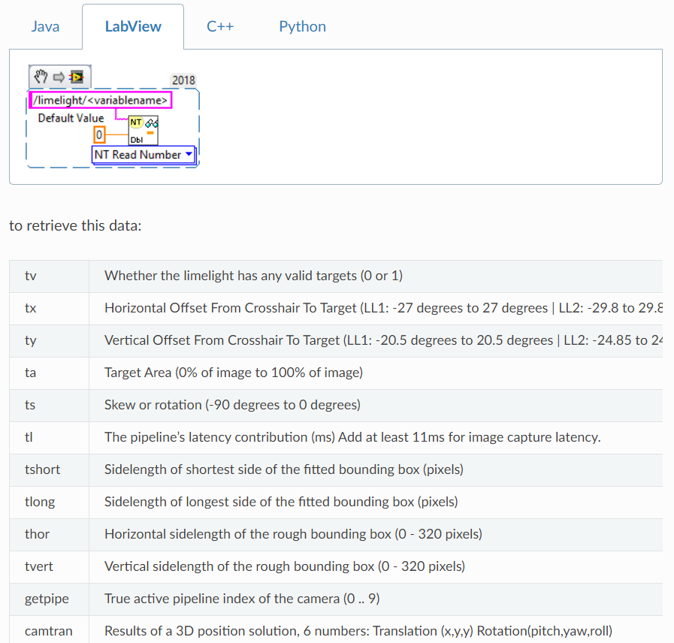
Limelight Vision Targeting
Objective:
Identify Vision Target(s)
Provide Yaw angle to target
Provide Distance to target
Provide Pitch angle to target
Limelight Documentation
http://docs.limelightvision.io/en/latest/
Go through it to capture and send Tx, Ty, Ta to Network tables
Receive them to Robot Code, Also display image to Dashboard
More parameters available to retrieve – see documentation

Slide 46
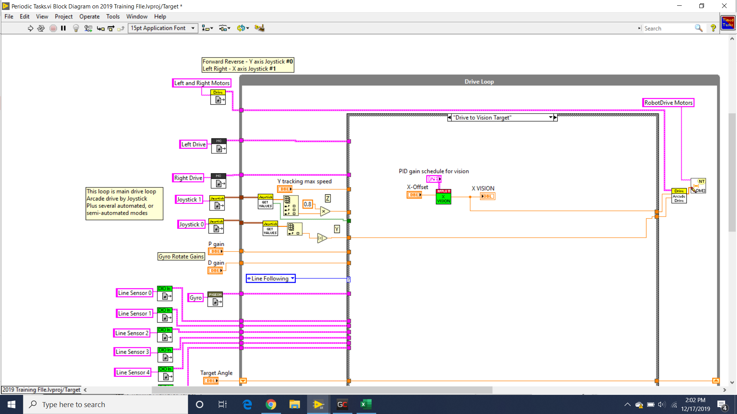
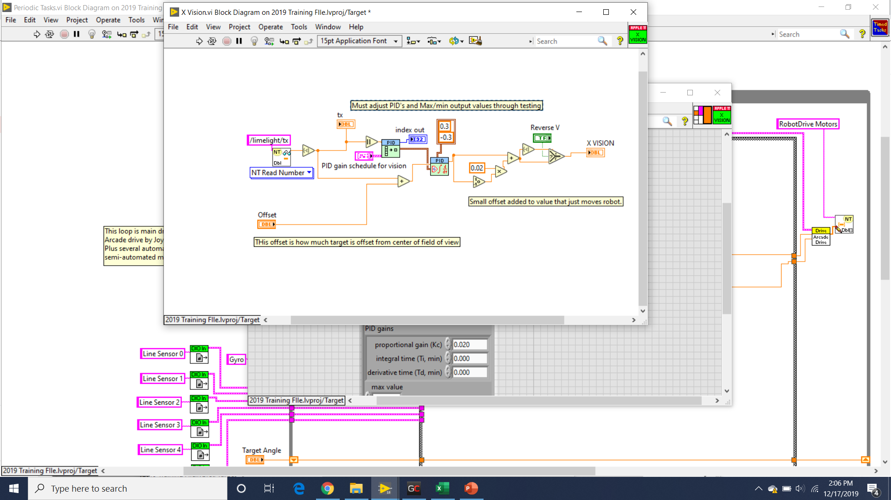
Vision Tracking – X Targeting Example
This will take the Tx value from the Limelight, by way of Network tables, and set a X value, into the Arcade drive block, to aim toward it.
Y remains controlled by driver but is limited by a set max speed

Slide 47
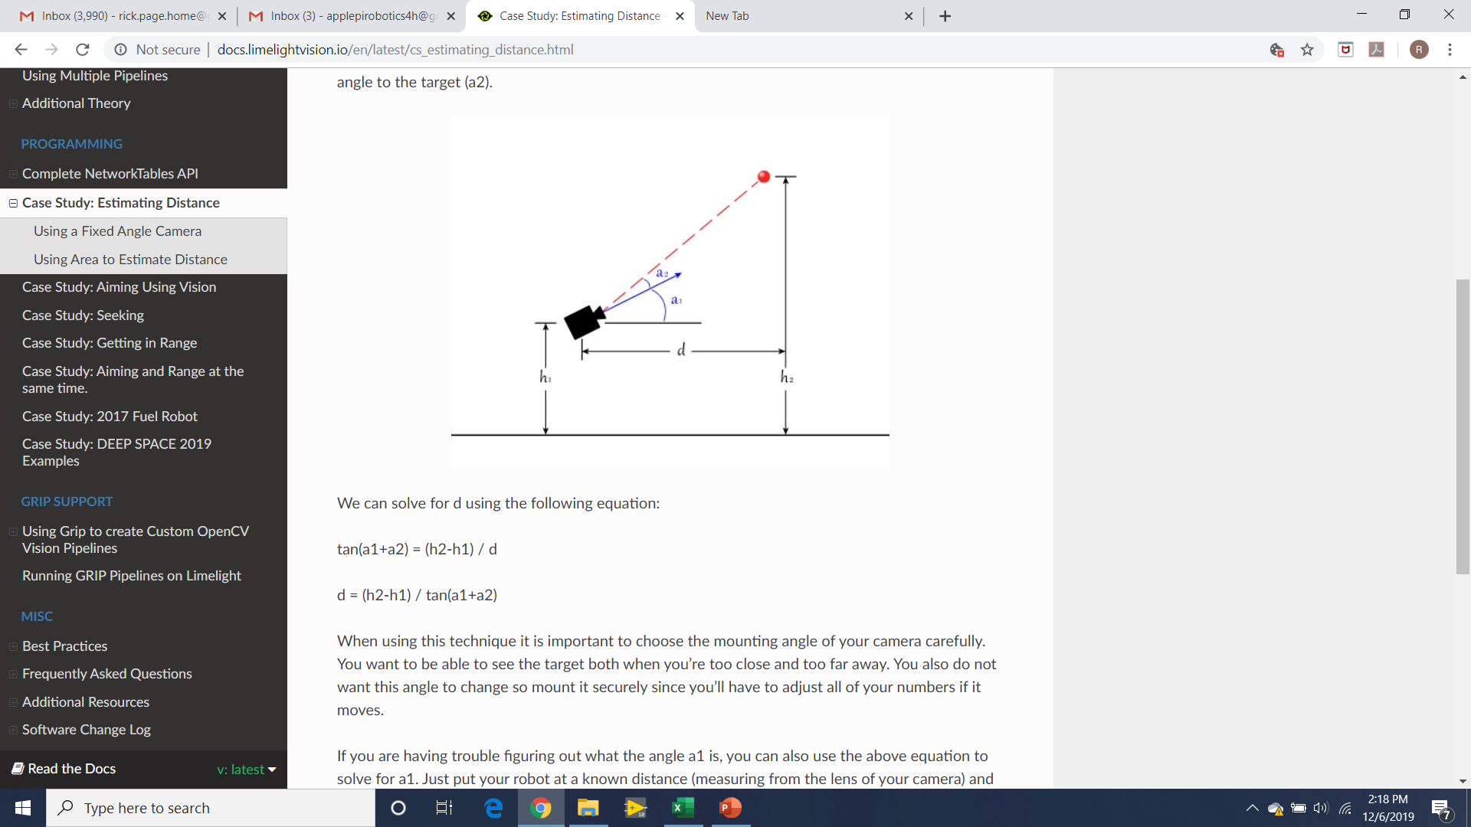
Getting the Angles
Ty and Tx provided directly
Can also determine Distance to target: d

Slide 48
Dashboard: Read/Write Network Tables and Limelight Vision

Slide 49
Vision Continued:
Use low resolution to reduce bandwidth and increase frames per second
Higher frames per second needed to reliably and quickly drive to target

Slide 50
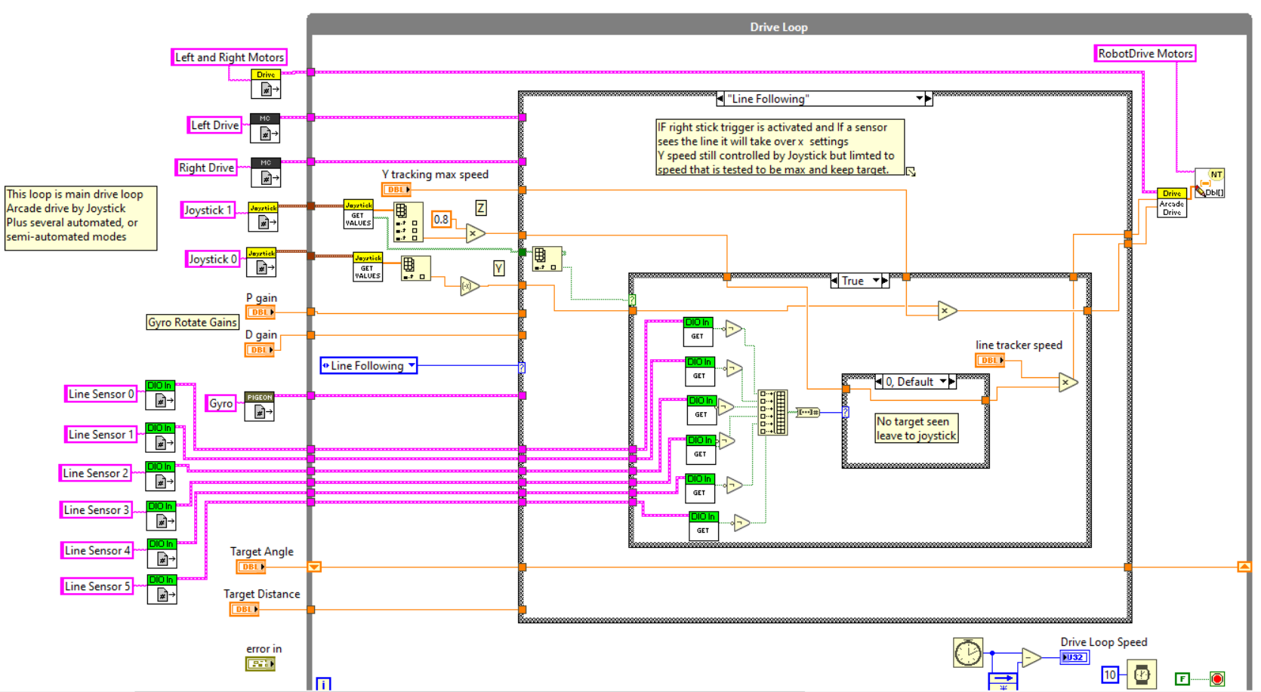
Line Following
This version uses 6 light sensors
X value is given depending which sensors seeing the line
Requires testing/tuning
This version keeps Y controlled by driver but limited to a set max speed
Each sensor will have a 1 or 0, these are concatenated into a Boolean number which is then converted to decimal value which ID’s the case number

Slide 51
Autonomous

Slide 52
Future Topics
Loose ends:
Saving controls on Front Panel so they don’t revert to 0 (or other default) after closing a project - (Right click, Edit, Set all as Default)
Building and Deploying a project onto a RoboRio
How to run a robot code without a robot? (useful to set up the logic at home before having robot at limited shop time)
Re-Imaging RoboRio, and web portal setting IP to Static
Imaging the Radio
Button latching
Lots more stuff covered in later chapters of Secret book.
Autonomous programming - Secret Book Plus
Dashboard and Network Tables - Refer to Secret Book but is there any new stuff?
Ultrasonic distance sensing
Second ”slot” for PIDF configuration
Differential Drive Motion Magic
Arbitrary Feed Forward
Path Following
Motion Profiling & Motion Profile Arc
Guide to Apple Pi Swerve Code
Swerve Track and Swerve Path
Read the rest of Secret Book for more ideas and techniques
Also read the SRX Phoenix Documentation (it takes a few times to sort it out!) to understand the feedback control and the various power within the SRX controllers.
Look at the Labview examples, and also the CTRE Labview examples

